Slide 1


Your guide to
Engineering
Education for a Sustainable Future

Slide 2

01. Introduction ……………………………………………………………………………………………………………………..…….… 8
02. Structure ……………………………………………………………………………………………………………………..….……………. 9
03. Content ……………………………………………………………………………………………………………………..………….…….... 19
content
04. Pedagogies ……………………………………………………………………………………………………………..………….…….... 19
05.
06.
Module 1 ……………..………………..…..………. 0
Module 2 ……………..………………..…..………. 0
Holistic Engineering for Impact: Integrating Systems Thinking, Social Responsibility, and Multidisciplinary Approach
Transversal Skills for Sustainable Engineering Leadership
07.
08.
Module 3 ……………..………………..…..………. 0
Module 4 ……………..………………..…..………. 0
Life Cycle Assessment
Innovating for Global Challenges
This project has been funded with support from the European Commission. The author is solely responsible for this publication (communication) and the Commission accepts no responsibility for any use may be made of the information contained therein. In compliance of the new GDPR framework, please note that the Partnership will only process your personal data in the sole interest and purpose of the project and without any prejudice to your rights.
© 2023. EESF Project. This work is openly licensed via CC BY 4.0.

Slide 3
01
Introduction
About this guide.
This guide has been developed to support the integration of the open educational course Engineering Education for a Sustainable Future (EESF). It introduces educators to the EESF framework and provides step-by-step guidance for teaching each of the sustainable competencies it outlines. The aim is to help educators foster a sustainabilly-oriented mindset in their students
.
This guide offers a variety of flexible resources and activities
that teachers can adapt to their classroom context.
Objective of this proposal.
The EESF project aims to equip teachers and students with the tools to develop a sustainability mindset. This mindset emphasizes thinking in the design of engineering solutions and projects, in order to be able to Identify and address challenges related to poverty, hunger, health, education, water and sanitation, inequality, and sustainable communities, fostering a holistic approach to improving well-being .
This course offers several activities with tools, examples, and practical cases that will be useful for channelling the SDGs toward specific objectives in your projects.
To this end, the EESF team has created this OER course, designed as a flexible training tool that teachers can use in the classroom or with students independently and in online learning environments. This guide aims to help train future engineers, particularly those focused on sustainability, to become more proactive in applying sustainable principles to their projects and in addressing the complex challenges facing humanity and our planet as a whole.

Slide 4
02
Structure
Main Objective.
This course is driven by the desire and need to embed a sustainable mindset into engineering learning.
The ultimate goal is to ensure this approach will be applied in professional practice, developing engineers who are aware of the need to ensure a sustainable future.
To support this goal, the EESF team has developed a list of 12 sustainable competencies that combine technical knowledge with creativity and innovation to solve complex and evolving problems. This requires a sustainable mindset that helps make the SDGs achievable.
For this reason, our learning model is based on acquiring a sustainability-oriented mindset. To this end, the EESF team has developed a list of competencies. sustainable that facilitate the acquisition of this new approach.
These competences are organized into in four thematic modules, offering educators flexibility in how they implement them in the classroom. The course is designed to be completed through a series of structured activities within each module. Competences are acquired through the resources that address the proposed topics and activities, in which the student puts into practice the knowledge and skills necessary to achieve it.
The proposed resources are straightforward and easy to integrate into existing curricula, requiring minimal additional time. Activities are structured across three levels—Basic (Level 1), Advanced (Level 2), and Integrative (Level 3)—with each level increasing in time commitment and complexity. This makes it a learning tool that's easy to implement due to its flexibility in extension. If the teacher or student has more time, they can also go as far as the integration activity, which allows the teacher to include content and activities in the subject they teach.
Each activity includes references that allow both teachers and students to explore topics in greater depth, depending on their time, interest, and curiosity.. Educators can evaluate their students' completion of the activities, but the guide includes a brief questionnaire to be administered at the end of the Basic Level 1 activity for each competency.

Slide 5
02
Structure
Time Graphs.
Below are tables that explain the time allotted to complete the course modules. The OER EESF course offers a flexible structure that allows you to move through the 12 competencies or choose to complete modules as needed.
Engineers for Sustainable Future OER's | Module | Minutes | Minutes | Hours
 | Module 1 | 325 - 540 | 1300 - 2160 | 21, 40' - 36
 | Module 2 | 325 - 540
 | Module 3 | 325 - 540
 | Module 4 | 325 - 540
It has two levels of complexity, Basic and Advanced, and a third level of Integration, in case the teacher has time to integrate these activities as content for their subject.
 |  |  | Activities | Minutes
Module |  | Competence 1 | Level 1 Basic | 15 - 30
 |  |  | Level 2 Advanced | 30 - 60
 |  |  | Integration Activity | 60 - 90
 |  | Competence 2 | Level 1 Basic | 15 – 30
 |  |  | Level 2 Advanced | 30 – 60
 |  |  | Integration Activity | 60 – 90
 |  | Competence 3 | Level 1 Basic | 15 – 30
 |  |  | Level 2 Advanced | 30 – 60
 |  |  | Integration Activity | 60 – 90
Due to its pyramid structure, you can choose to go through its contents in levels, choosing to first complete level 1 of all modules, adapting it to the level of your students.
Engineers for Sustainable Future OER's | Level 1 Basic | 180' - 360' | 3h - 6 h
 | Level 2 Advanced | 360' - 720' | 6am - 12pm
 | Integration Activity | 720' - 1080' | 12 pm - 6 pm

Slide 6
02
Structure
Course objectives.
The objective of this REA EESF course, structured around four thematic modules, is to enable students to apply the knowledge and skills acquired during their training, by adopting a sustainable mindset and a systemic vision to propose, solve, and develop engineering projects.
Engineers for Sustainable Future OER's.
Module 1.
Module 2.
Transversal Skills for Sustainable Engineering Leadership
Holistic Engineering for Impact: Integrating Systems Thinking, Social Responsibility, and Multidisciplinary Approach
Module 3.
Module 4.
Life Cycle Assessment
Innovating for Global Challenges
Modules by Thematic Areas

Slide 7
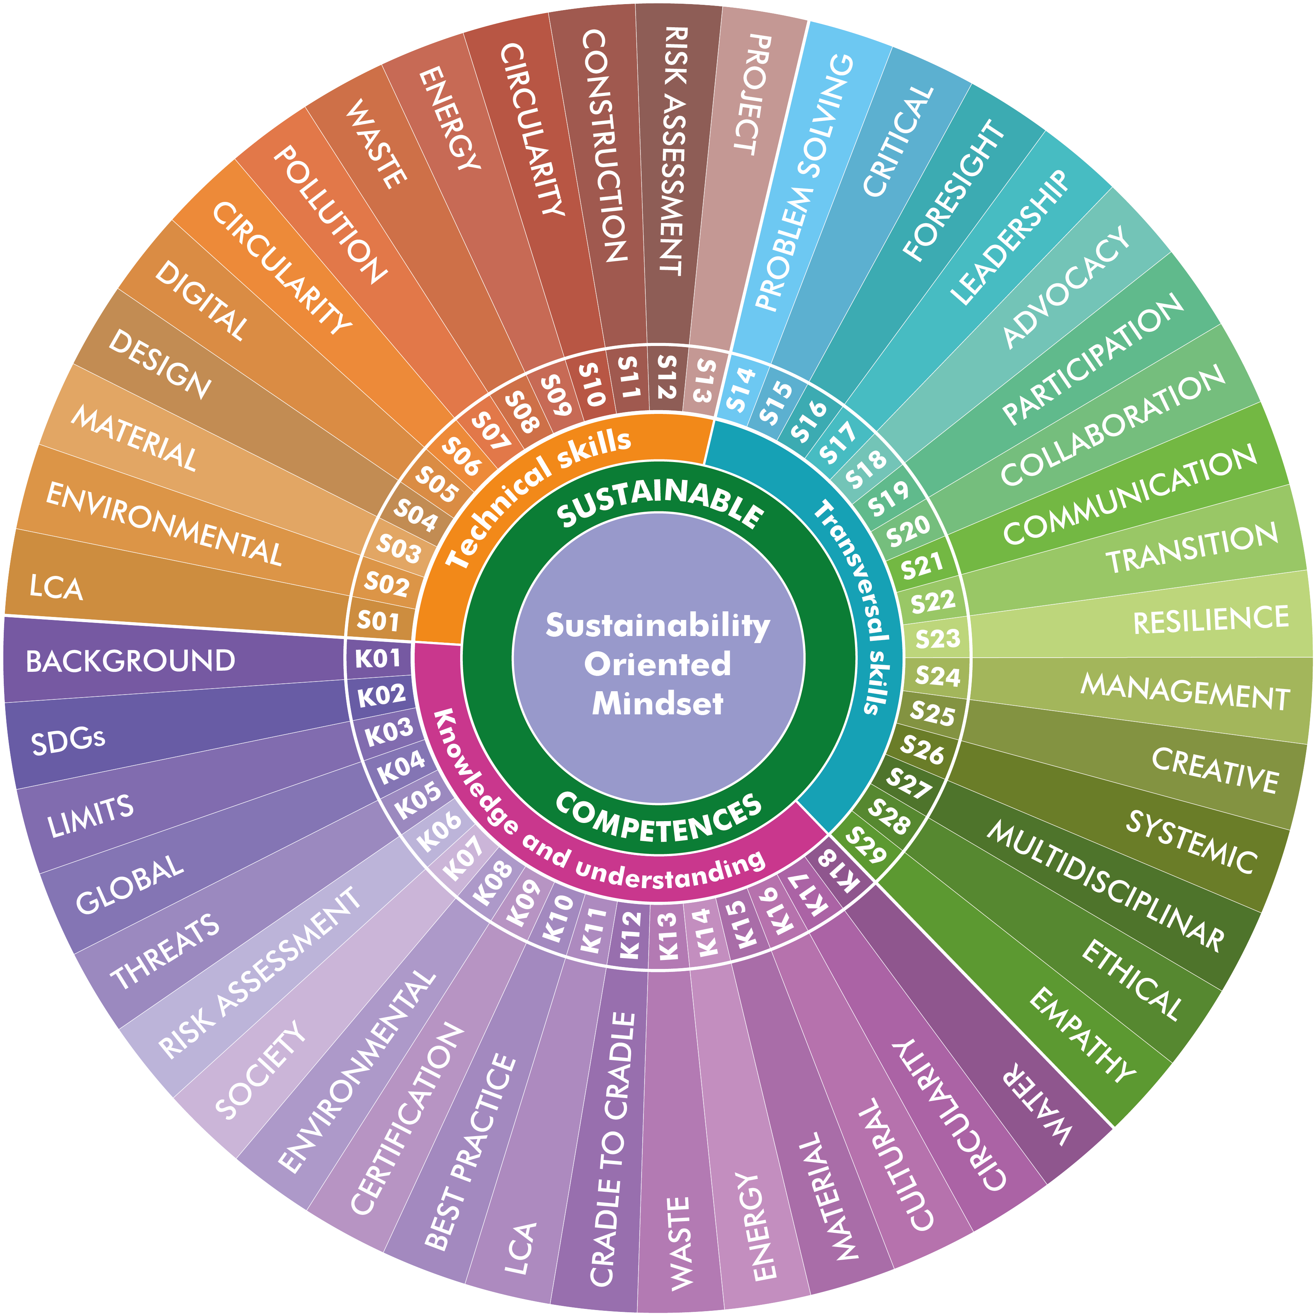
02
03
Structure
OERs Diagram _ Skills and Knowledge.
The transversal and specific skills targeted in this carousel, along with the selected knowledge, are designed to complement he competencies students have already acquired.
They are intended to be applicable across all fields of engineering and can be adapted to suit specific disciplines or contexts, depending on the instructor’s objectives. These skills and knowledge aim to support students in both their ongoing education and future professional practice.

Slide 8
02
Structure
OERs Diagram _ Competencies.
The 12 sustainable competencies developed for engineering are the core of this course. They define the essential skills and knowledge to be acquired through the proposed activities.
The aim is to empower students to address complex problems with a sustainable mindset. Each thematic module develops three competencies to offer a flexible training approach.

Slide 9
02
03
Structure
Competencies .
Competencies are defined as “articulated sets of knowledge, capabilities, skills, dispositions, attitudes, and aptitudes that enable us to understand and analyse problems or situations and act coherently and effectively, individually or collectively, in specific contexts.”
Competencies are defined as “articulated sets of knowledge, capabilities, skills, dispositions, attitudes, and aptitudes that enable us to understand and analyse problems or situations, and to act coherently and effectively, individually or collectively, in specific contexts.”
They are assessable through learning outcomes and can be demonstrated through the ability to apply personal, social, professional, and methodological knowledge, skills, and abilities in work or study situations, as well as in professional and personal development. Competencies are inherent to individuals, and they continue to develop them through their professional practice and lifelong learning .
Competencies and Learning Outcomes , which are sometimes used interchangeably, are the starting point and the heart of any teaching process as they define what we want the student to achieve, at the educational level.
This course, through its four modules, seeks to empower students to carry out their work with a sustainable mindset, an integrative approach, and systemic thinking. This training will be made possible thanks to a set of activities that students will complete using short, simple resources to designed for classroom use. These activities aim to generate a shift in perspective and knowledge that the student will be able to integrate into their daily life and with the rest of their technical expertise.
Therefore, learning outcomes are statements of what a student is expected to know, understand and/or be able to demonstrate after completing a learning process (according to the Tuning Glossary of Educational Structures ). In this way, the Learning Outcome will begin with the phrase “the student will be able to…”, followed by the verb that expresses the competence.

Slide 10
02
Structure
Learning Outcomes .
The choice of the appropriate verb in the competency
statement is essential, as it will determine the level of
complexity the student will faces and, therefore,
the expected level of training.
To achieve this, it is necessary to take into account the educational level to adjust the depth and complexity of the proposed activities, as well as the time for their development. Training evolves over time, not only in terms of extent but also in complexity. Therefore, a first-year student is not the same as one who is about to submit their Final Degree Project.
A selection of knowledge areas related to Sustainability and Engineering has been selected, allowing for a different approach. The same has been done with skills , which have been divided into cross-cutting and specific or technical areas.

Slide 11
02
Structure
Learning Outcomes .
The framework of 12 competences , 29 skills , and 18 knowledge areas, along with the list of 22 teaching methodologies or pedagogies, constitutes tool for generating activities that can be adapted in the future to more specific or general interests.
Meanwhile, the course we offer, Engineering Education
for a Sustainable Future , is a sample of the many possibilities available and will help teachers and students develop the
desired sustainable mindset.
Therefore, we are talking about two important tools: on the one hand, the structure that underpins he course, and on the other, the proposed four modules that will capture the interest and attention of students, highlighting the direct relationship between their future profession and the management of solutions that take into account sustainability.
Module 1.
Transversal Skills for Sustainable Engineering Leadership
C10 Cultural & Multidisciplinary Perspectives
C11 Ethical & Social Responsibility
C10 Interconnected Environment, Society & Economy
Module 2.
Holistic Engineering for Impact: Integrating Systems Thinking, Social Responsibility, and Multidisciplinary Approach
C09 Sustainable Strategies & Strategic Planning
C08 Sustainable Transition Leadership
C07 Sustainable Project Management
Module 3.
Life Cycle Assessment
C06 LCA & Environmental Impact Assessment
C05 ACV Methodology
C04 Impacts of Products & Services
Module 4.
Innovating for Global Challenges
C03 Sustainable & Resilient Infrastructures & Cities
C02 Environmental Effects of Transportation
C01 Minimizing the Carbon Footprint
Competences developed by each module

Slide 12
02
Structure
Competencies and Learning Outcomes.
Integrating sustainability into engineering education:
a comprehensive competency framework
Faced with accelerating global challenges—climate change, resource depletion, social inequality, and environmental degradation—engineering education must evolve to prepare professionals capable of designing solutions that are not only technically sound but also ethically responsible and environmentally sustainable. To achieve this, a comprehensive set of competencies has been developed to guide the integration of sustainability into engineering curricula across all disciplines.
At the heart of this framework is the ability to understand and reduce the carbon footprint associated with energy systems. Engineers must be able to evaluate energy sources not only in terms of efficiency and cost, but also from an environmental impact perspective, applying fundamental energy principles and comparative analyses. This understanding extends to the transportation sector, where engineers are called upon to innovate in logistics, mobility, and tourism systems to reduce emissions and improve sustainability.
Equally crucial is the ability to design sustainable and resilient infrastructure and urban environments. This involves anticipating the risks of climate change, promoting distributed renewable energy systems, implementing circular supply chains, and integrating nature-based solutions. These approaches require a deep understanding of the life cycle of products and processes. Engineers must master life cycle assessment (LCA) methodologies, be able to quantify environmental impacts, and incorporate risk analysis to ensure long-term sustainability.
Resource efficiency is another pillar of this competency framework. Engineers must be trained to optimize energy use and material selection, integrating renewable resources and sustainable manufacturing practices that prioritize durability, recyclability, and minimal environmental impact. These technical skills must be complemented by the ability to manage projects with a focus on sustainability: strategic planning, risk mitigation, and alignment of initiatives with relevant policies, regulations, and certifications.
In addition to technical expertise, engineers must also develop leadership skills to drive sustainability transitions within organizations. This includes ethical decision-making, implementing corporate social responsibility (CSR) strategies, and understanding the financial and business dimensions of sustainability. Strategic foresight becomes essential, as engineers must anticipate long-term trends, assess geopolitical and economic influences, and develop adaptive strategies that ensure resilience in a rapidly changing world.

Slide 13
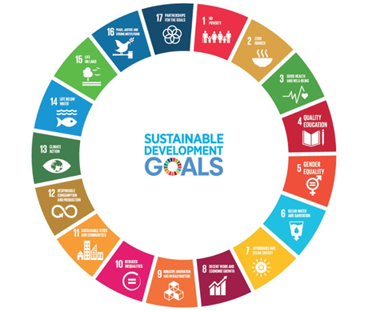
02
Structure
Competencies and Learning Outcomes.
A systems approach is fundamental to this educational model. Engineers must recognize the interdependence of environmental, social, and economic systems, designing solutions that respect planetary boundaries and acknowledge the finite nature of resources. Ethical and social responsibility must be embedded in every decision, ensuring that engineering practices promote environmental justice, equity, and accountability.
Finally, a truly global and inclusive perspective is essential. Engineers must be able to integrate cultural and multidisciplinary perspectives, including Indigenous knowledge systems, to develop contextually relevant and globally applicable solutions. This holistic approach ensures that sustainability is not considered an add-on, but a core element of engineering practice.
The integration of these interconnected themes into engineering education represents a transformative shift toward sustainability. By incorporating this framework into curricula, institutions can develop engineers who are not only technically competent, but also visionary, responsible, and capable of leading the transition to a more sustainable and equitable future.
This competency framework not only responds to an educational need but is also closely aligned with the 2030 Agenda and its 17 Sustainable Development Goals (SDGs), the achievement of which requires a structural transformation in the way engineering is conceived, taught, and practiced. As highlighted in the UNESCO report “Engineering for Sustainable Development: A Global Perspective,” engineering plays a fundamental role in designing innovative solutions to address interconnected challenges such as climate change, poverty, inequality, and environmental degradation. Therefore, engineering must transcend its traditional focus and assume its responsibility as a driver of sustainability and global justice.
This new paradigm demands a profound reorientation of education, through which future engineers are trained not only to solve technical problems but also to anticipate social, ecological, and ethical impacts, and to critically and proactively integrate these considerations into their professional decisions. The competency framework proposed here offers a coherent roadmap for preparing professionals who can actively contribute to achieving the SDGs, integrating systems thinking, the inclusion of diverse knowledge systems, responsible innovation, and collective action.
Only through this transformation in engineering education can we move toward truly sustainable development, where technology and knowledge serve the common good and respect the limits of the planet. Adopting this vision is not only a desirable option, but an urgent necessity if we are to ensure a liveable, just, and resilient future for generations to come

Slide 14
03
Content
Academic Program_List of Competencies.
CO1 MINIMIZING THE CARBON FOOTPRINT
Ability to qualitatively analyse the carbon footprint associated with different energy sources. Energy principles, comparison variables.
……………………………………………………………………………………………………………………….……………………………………………….……..………………………
CO2 ENVIRONMENTAL EFFECTS OF TRANSPORTATION
Ability to apply engineering knowledge, experience, and innovation to transportation, logistics, freight transport, passenger transport, and tourism.
……………………………………………………………………………………………………………………….……………………………………………….……..………………………
C03 SUSTAINABLE AND RESILIENT INFRASTRUCTURES AND CITIES
Ability to develop sustainable and resilient infrastructure and city models, identifying and understanding the risks posed by climate change, implementing sustainable mobility strategies, distributed renewable energy generation, circular supply chains, and nature-based solutions and forward-looking scenarios.
……………………………………………………………………………………………………………………….……………………………………………….……..………………………
C04 IMPACTS OF PRODUCTS AND SERVICES
Ability to perform life cycle and environmental impact assessments, evaluating the environmental impact of products and processes, applying life cycle analysis (LCA) and carbon footprint calculations, and incorporating risk assessment methodologies to ensure sustainable engineering outcomes.
……………………………………………………………………………………………………………………….……………………………………………….……..………………………
C05 ACV METHODOLOGY
Ability to understand methodologies such as the LCA methodology that determines the environmental impacts of products considering their life cycle, being able to identify the different phases and steps according to the ISO 14040:2006 series of standards.
……………………………………………………………………………………………………………………….……………………………………………….……..………………………
C06 LCA AND ENVIRONMENTAL IMPACT ASSESSMENT
Ability to perform life cycle and environmental impact assessments by evaluating the environmental impact of products and processes considering their life cycle, applying the life cycle assessment (LCA) methodology, including carbon footprint calculations to ensure sustainable engineering results .
……………………………………………………………………………………………………………………….……………………………………………….……..………………………
C07 SUSTAINABLE PROJECT MANAGEMENT
Ability to manage sustainability-focused projects through strategic planning, risk mitigation, coordination of sustainability initiatives, and ensuring alignment with sustainability-related policies, regulations, and certifications.
……………………………………………………………………………………………………………………….……………………………………………….……..………………………
C08 SUSTAINABLE TRANSITION LEADERSHIP
Ability to lead sustainability transitions by driving change in engineering organizations, making ethical decisions, implementing corporate social responsibility (CSR) frameworks, and understanding how sustainability connects to business and finance.

Slide 15
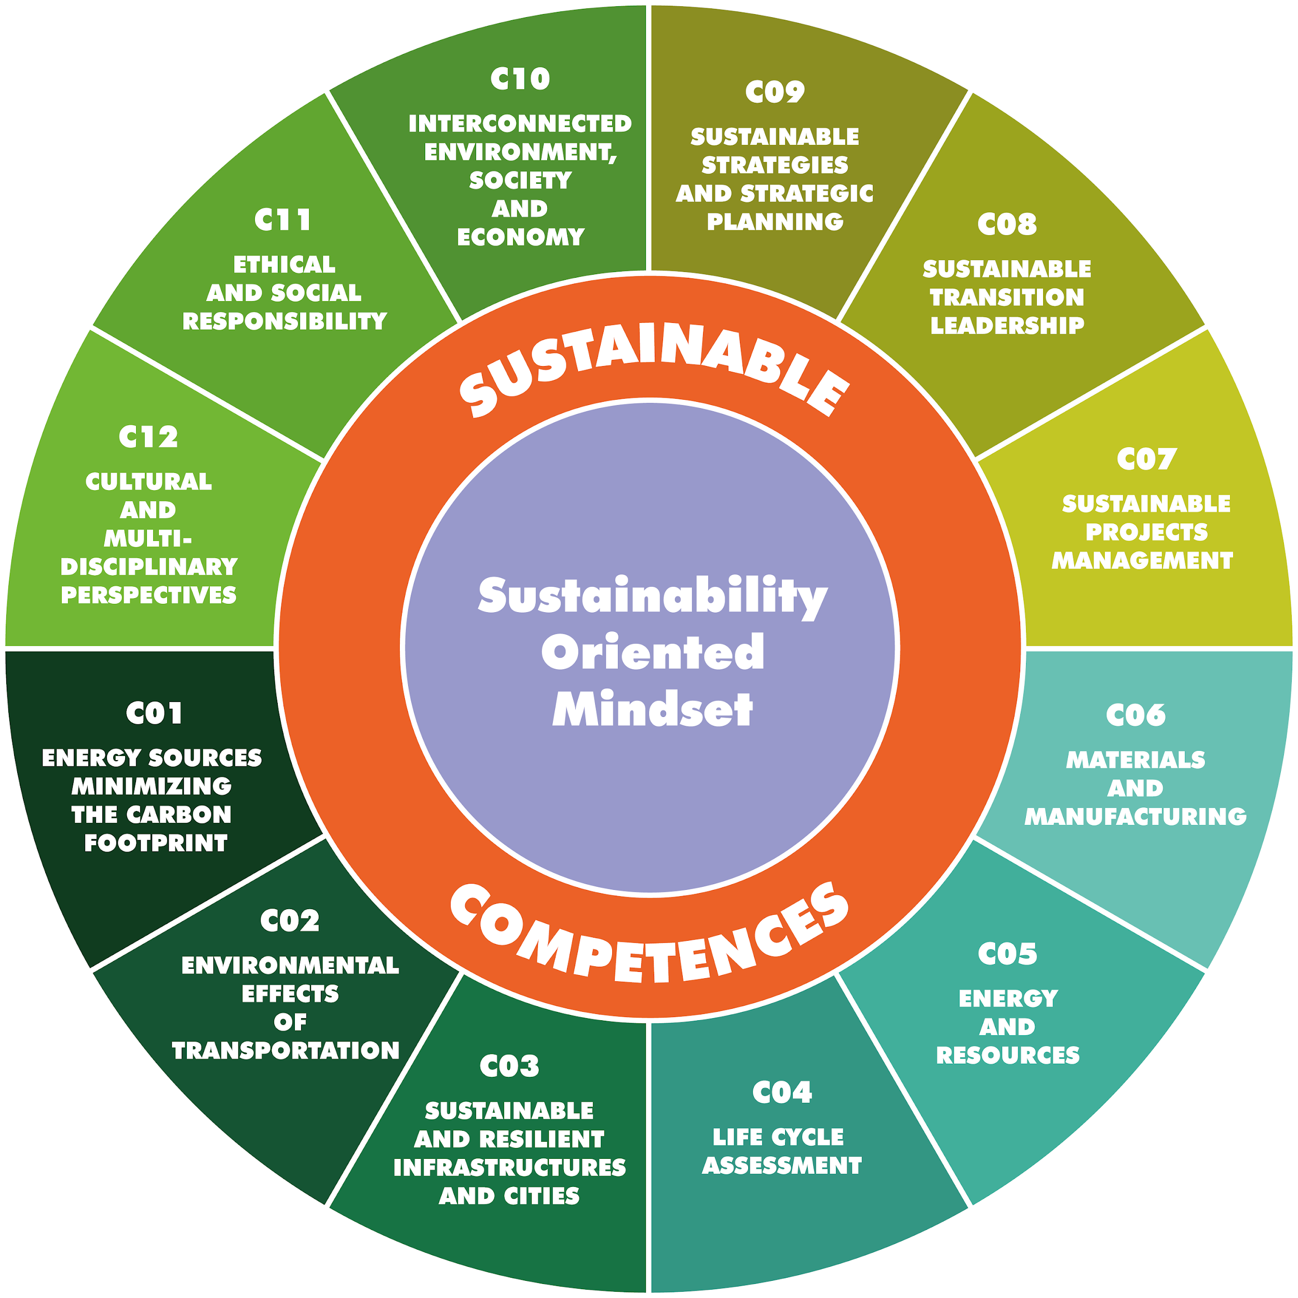
03
Content
Academic Program_List of Competencies.
C09 SUSTAINABLE STRATEGIES AND STRATEGIC PLANNING
Ability to apply strategic foresight and scenario planning by analysing long-term sustainability trends, anticipating risks, and integrating adaptive strategies into engineering projects, taking into account geopolitical and economic influences that shape sustainability policies, resource availability, and global market dynamics.
……………………………………………………………………………………………………………………….……………………………………………….……..……………………
C10 INTERCONNECTED ENVIRONMENT, SOCIETY AND ECONOMY
Ability to apply systems thinking to sustainability engineering by recognizing and addressing the interconnections between environmental, social, and economic factors, while designing solutions that remain within planetary boundaries and take into account the finite availability of resources.
……………………………………………………………………………………………………………………….……………………………………………….……..……………………
C11 ETHICAL AND SOCIAL RESPONSIBILITY
Ability to integrate ethical and social responsibility into sustainability decisions, considering environmental justice, corporate responsibility, and social equity.
……………………………………………………………………………………………………………………….……………………………………………….……..……………………
C12 CULTURAL AND MULTIDISCIPLINARY PERSPECTIVES
Ability to incorporate cultural and multidisciplinary perspectives into sustainability by integrating diverse viewpoints, including indigenous knowledge, to create globally relevant solutions.

Slide 16
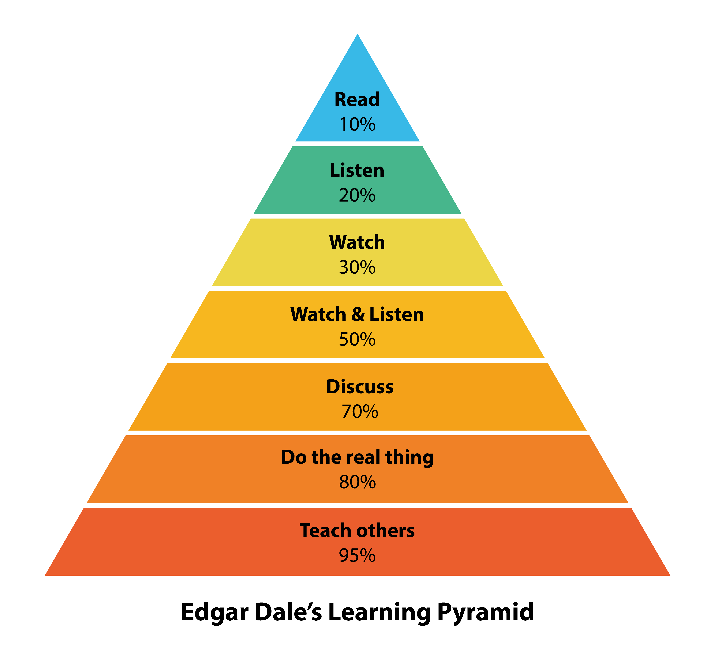
03
03
Content
Resources and Teaching Methodologies.
Facilitating learning is the ultimate goal of any educational methodology. Edgar Dale's learning pyramid shows which activities enable people to learn more and better.
This diagram shows that greater student participation translates into higher levels of learning.
Innovative educational methodologies address students' concerns to facilitate their access to their own world and capture their attention, allowing them to develop the skills they need. When we talk about innovative or active educational methodologies, we refer to proposals or activities implemented with the goal of dynamic teaching, seeking a more participatory learning process that places the student at the centre of the system. The implementation of new educational methodologies is being adopted worldwide, promoting better academic outcomes for students.

Slide 17
03
Content
Resources and Teaching Methodologies.
Sustainability begins in the classroom.
Learning to think and act sustainably in engineering depends not only on the content but also on how it is taught. Active methodologies transform students into committed problem solvers, ready to face real-world challenges with responsibility and vision.
Fostering a sustainable mindset in the field of engineering requires more than just the transmission of technical knowledge; it requires a transformative pedagogical approach that places the student at the centre of the learning process, appealing to their commitment, critical thinking, and ability to act ethically and responsibly. Therefore, the course has been designed from a methodological perspective aligned with the principles of meaningful learning, structured around twelve core competencies that address different dimensions of sustainability: energy, environmental, urban, ethical, social, economic, and cultural. This structure is organized into four modules, each focused on three competencies, with activities divided into three progressive levels of complexity (basic, advanced, and integrative), in line with Bloom's taxonomy as revised by Anderson and Krathwohl, which guides cognitive development from remembering and understanding to applying, analysing, evaluating, and creating.

Slide 18
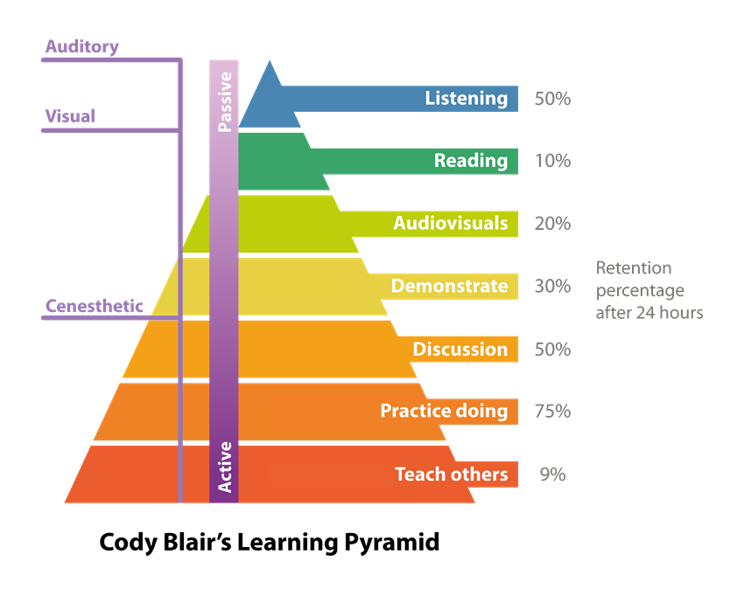
03
Content
Resources and Teaching Methodologies.
Active learning methodologies have been prioritized, where students are not passive recipients of information, but actively transform and apply it in real-life and challenging contexts
Accordingly, the course offers resources such as case studies, analytical videos, supporting texts, infographics, and diagrams, with the aim of devoting the majority of the course time to meaningful activities. This approach is based on widely recognized pedagogical evidence. As presented in Edgar Dale's (1969) Cone of Experience, methods that involve direct and active participation lead to deeper and more lasting understanding compared to approaches based solely on reading or listening. While Dale did not assign retention percentages to each level of the cone, his work was later reinterpreted in line with Bloom's framework, notably by Anderson and Krathwohl, which emphasizes action, creativity, and critical judgment as advanced learning outcomes. Similarly, the well-known Active Learning Pyramid, popularized by educators such as Cody Blair, presents a hierarchy of teaching methods based on the degree of student engagement.
This model suggests that learning by doing, applying knowledge in real-life contexts, and teaching others are among the most effective strategies. While the specific percentages often associated with these diagrams should be interpreted with caution, as they are not based on systematic empirical research, their value lies in highlighting the importance of student-centred , contextualized , and participatory learning.

Slide 19
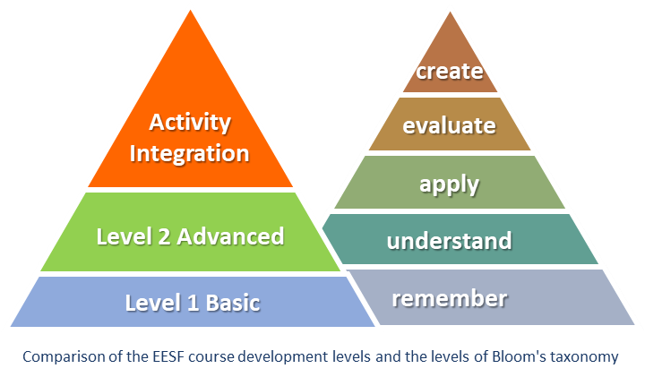
03
Content
Resources and Teaching Methodologies.
Twelve competencies, three levels,
one shared purpose.
The course design structures the learning progression through activities aligned with the revised Bloom's Taxonomy.
This organization , based on systems thinking and key competencies for sustainability, ensures that technical knowledge is meaningfully linked to action, reflection, and ethical judgment.
This model suggests that learning by doing, applying knowledge in real-life contexts, and teaching others are among the most effective strategies. While the specific percentages often associated with these diagrams should be interpreted with caution, as they are not based on systematic empirical research, their value lies in highlighting the importance of student-centred, contextualized, and participatory learning.
This principle takes on particular relevance when learning time is limited. In these contexts, active methodologies maximize educational impact by promoting the transfer of knowledge to real-life situations, closely aligned with the professional competencies required for sustainability-oriented engineering

Slide 20
03
Content
Resources and Teaching Methodologies.
There is sustainability without
educational transformation
The use of active methodologies not only improves learning within limited timeframes but also represents a strategic commitment to training professionals capable of leading change. Learning by doing, reflecting, and collaborating is, now more than ever, a necessary condition for engineering that truly contributes to a fair and sustainable future
The selection of specific methodologies for each activity is not arbitrary, but rather responds to the type of competency being developed and the desired cognitive level. Thus, Level 1 (basic) activities are based on guided discovery, video analysis, or structured exercises; Level 2 (advanced) tasks employ methods such as case studies, simulations, or challenge-based learning; while integrative activities are based on project-based learning (PBL), design thinking, and peer collaboration, allowing students to systematically apply knowledge and skills in professional situations.
Overall, this methodological design seeks not only to facilitate the achievement of learning outcomes but also to foster an active, reflective, and transformative attitude in students. Only through authentic, participatory, and stimulating learning experiences will it be possible to advance toward engineering education aligned with the challenges of the 21st century, where the development of technical skills goes hand in hand with critical awareness and a firm commitment to sustainability..
Explanatory notes for the reader:.
Bloom's taxonomy revised by Anderson and Krathwohl introduces a more structured cognitive dimension to designing learning objectives, progressing from Remembering, Understanding, Applying, Analysing , Evaluating, to Creating .
Edgar Dale did not assign retention percentages to his Cone of Experience. The figures commonly associated with the model were introduced later and should be used with caution, primarily as pedagogical examples rather than as empirical The "Active Learning Pyramid," popularized by Cody Blair and other educators, visually ranks learning strategies according to their effectiveness based on student engagement. Although not derived from a single empirical study, the model is widely used in educational design to promote experiential and student-centred learning .

Slide 21
03
Content
Academic Program - List of skills and knowledge.
Cross-curricular skills :
S01 LIFE CYCLE ASSESSMENT SKILLS
…………………………………………………………………………………………………………………………….…………………………………………………………
S02 ENVIRONMENTAL Skills to assess environmental impact
…………………………………………………………………………………………………………………………….…………………………………………………………
S03 MATERIALS Skills for selecting sustainable materials
…………………………………………………………………………………………………………………………….…………………………………………………………
S04 DESIGN Skills to design with a sustainable approach
…………………………………………………………………………………………………………………………….…………………………………………………………
S05 DIGITAL Skills to use digital tools for sustainability
…………………………………………………………………………………………………………………………….…………………………………………………………
S06 CIRCULARITY Skills for the implementation of the circular economy
and optimization
…………………………………………………………………………………………………………………………….…………………………………………………………
S07 POLLUTION Skills to use pollution prevention strategies
…………………………………………………………………………………………………………………………….…………………………………………………………
S08 WASTE Skills to implement waste management for sustainability
…………………………………………………………………………………………………………………………….…………………………………………………………
S09 ENERGY Skills to seek energy performance and resource efficiency
…………………………………………………………………………………………………………………………….…………………………………………………………
S10 DATA Skills to use simulation and data analysis for sustainability
…………………………………………………………………………………………………………………………….…………………………………………………………
S11 CONSTRUCTION Skills to promote sustainable construction
…………………………………………………………………………………………………………………………….…………………………………………………………
S12 RISK Skills to give importance to risk assessment for sustainability
…………………………………………………………………………………………………………………………….…………………………………………………………
S13 PROJECTS Skills to identify opportunities to improve
sustainability in projects
…………………………………………………………………………………………………………………………….…………………………………………………………

Slide 22
03
Content
Academic Program - List of skills and knowledge.
Specific skills and techniques :
S14 PROBLEM SOLVING Complex problem-solving skills
…………………………………………………………………………………………………………………………….…………………………………………………………
S15 CRITICAL Critical thinking skills
…………………………………………………………………………………………………………………………….…………………………………………………………
S16 FORECAST Skills for strategic foresight and scenario planning
…………………………………………………………………………………………………………………………….…………………………………………………………
S17 LEADERSHIP Leadership skills for sustainability
…………………………………………………………………………………………………………………………….…………………………………………………………
S18 ADVOCACY Defending skills for sustainability
…………………………………………………………………………………………………………………………….…………………………………………………………
S19 PARTICIPATION Skills to generate engagement with stakeholders, negotiation and conflict management.
…………………………………………………………………………………………………………………………….…………………………………………………………
S20 COLLABORATOR Skills to collaborate with a variety of
stakeholders and disciplines
…………………………………………………………………………………………………………………………….…………………………………………………………
S21 COMMUNICATION Effective communication skills with a variety of audiences
…………………………………………………………………………………………………………………………….…………………………………………………………
S22 TRANSITION Change and transition management skills
for sustainability
…………………………………………………………………………………………………………………………….…………………………………………………………
S23 RESILIENCE Resilience and adaptability skills in sustainability projects
…………………………………………………………………………………………………………………………….…………………………………………………………
S24 MANAGEMENT Project management and sustainability engineering
…………………………………………………………………………………………………………………………….…………………………………………………………
S25 CREATIVE Skills for creativity and innovation
…………………………………………………………………………………………………………………………….…………………………………………………………
S26 SYSTEMIC Skills to apply systemic thinking
…………………………………………………………………………………………………………………………….…………………………………………………………
S27 MULTIDISCIPLINARY Skills to work with multidisciplinary
approaches and environments
…………………………………………………………………………………………………………………………….…………………………………………………………
S28 ETHICS Skills to include an ethical approach in problem solving
…………………………………………………………………………………………………………………………….…………………………………………………………
S29 EMPATHY Skills to understand users' needs and improve people's lives

Slide 23
03
Content
Academic Program - List of skills and knowledge.
Knowledge and understanding :
K01 BACKGROUND The evolution of sustainability and the SDGs
……………………………………………………………………………………………………………………….…………………………………………………………………………
K02 SDGs Connection between engineering and sustainability and the SDGs
……………………………………………………………………………………………………………………….…………………………………………………………………………
K03 LIMITS Planetary boundaries and current status of critical resources
……………………………………………………………………………………………………………………….…………………………………………………………………………
K04 GLOBAL Geopolitical and economic influences on sustainability
……………………………………………………………………………………………………………………….…………………………………………………………………………
K05 THREATS Main environmental threats and how they are measured
……………………………………………………………………………………………………………………….…………………………………………………………………………
K06 RISK Sustainability
……………………………………………………………………………………………………………………….…………………………………………………………………………
K07 SOCIETY Sustainability and social systems
……………………………………………………………………………………………………………………….…………………………………………………………………………
K08 ENVIRONMENT Sustainability and the environment
……………………………………………………………………………………………………………………….…………………………………………………………………………
K09 CERTIFICATION Sustainability-related policies, regulations,
and certifications relevant to engineering
……………………………………………………………………………………………………………………….…………………………………………………………………………
K10 BEST PRACTICES Best sustainability practices in engineering projects
……………………………………………………………………………………………………………………….…………………………………………………………………………
K11 LCA Life cycle approach and application
……………………………………………………………………………………………………………………….…………………………………………………………………………
K12 CRADLE TO CRADLE Circular design from crib to crib
……………………………………………………………………………………………………………………….…………………………………………………………………………
K13 WASTE Waste management
……………………………………………………………………………………………………………………….…………………………………………………………………………
K09 ENERGY Clean energy, future energy systems, and emerging green technologies
……………………………………………………………………………………………………………………….…………………………………………………………………………
K10 MATERIAL Classification of materials from an environmental perspective (recyclable, renewable, bio-based)
……………………………………………………………………………………………………………………….…………………………………………………………………………
K11 CULTURAL Cultural differences in approaches to sustainability
……………………………………………………………………………………………………………………….…………………………………………………………………………
K12 CIRCULARITY Circular supply chain and sustainable resource management
……………………………………………………………………………………………………………………….…………………………………………………………………………
K13 WATER Water management

Slide 24
03
Content
Academic Program - List of Teaching Methods.
Pedagogical Methods:
P01 Problem-Based Learning (PBL) Students solve real-life sustainability challenges in groups.
……………………………………………………………………………………………………………………….…………………………………………………………………………
P02 Case-based learning Students analyse practical engineering cases with sustainability dilemmas.
……………………………………………………………………………………………………………………….…………………………………………………………………………..…
P03 Design Thinking Structured to foster innovation and empathy in
addressing SDG challenges.
……………………………………………………………………………………………………………………….…………………………………………………………………………
P04 Role-playing and simulation Students take on roles in stakeholder negotiations (e.g., sustainability planning, climate agreements).
………………………………………………………………………………………………………………………….………………………………………………………………..…………
P05 Socratic Seminar/Debate Used to critically analyse controversial sustainability issues.
……………………………………………………………………………………………………………………….…………………………………………………………………………
P06 Service-Learning Connects classroom content with community sustainability projects.
……………………………………………………………………………………………………………………….…………………………………………………………………………
P07 Global Café / Fishbowl Debate Facilitates inclusive conversations
about complex issues related to the SDGs.
……………………………………………………………………………………………………………………….…………………………………………………………………………
P08 Flipped Classroom Students interact with OER videos or texts
before class; class time is used for application and problem-solving.
……………………………………………………………………………………………………………………….…………………………………………………………………………
P09 Microlearning Short, targeted digital learning units (videos,
infographics, quizzes) related to the SDGs.
……………………………………………………………………………………………………………………….…………………………………………………………………………
P10 Gamification Using points, badges, or scenarios to motivate participation in sustainability topics.
……………………………………………………………………………………………………………………….…………………………………………………………………………
P11 Creative/Digital Storytelling Students create materials (e.g., posters, videos, or multimedia) to explore sustainability issues.

Slide 25
03
Content
Academic Program - List of Teaching Methods.
Pedagogical Methods:
P12 WebQuests / Guided Inquiry. Students use selected online resources to explore and present sustainability topics.
……………………………………………………………………………………………………………………………….…………………………………………………………………
P13 Collaborative wikis or digital boards (e.g., Padlet , Miro) are used for collaborative knowledge building on sustainability engineering topics.
……………………………………………………………………………………………………………………………….…………………………………………………………………
P14 Challenge-Based Learning Teams address real-world SDG-related challenges over time using interdisciplinary methods.
……………………………………………………………………………………………………………………………….…………………………………………………………………
P15 Peer Learning/Peer Review. Students provide feedback or support to
each other in developing ideas or projects .
……………………………………………………………………………………………………………………………….…………………………………………………………………
P16 Project-based learning Long-term projects focused on sustainability, implemented in a variety of formats.
……………………………………………………………………………………………………………………………….…………………………………………………………………
P17 Inquiry-Based Learning Students generate questions and explore engineering issues related to the SDGs using inquiry methods.
……………………………………………………………………………………………………………………………….…………………………………………………………………
P18 Learning through teaching Students research a topic (e.g., an SDG)
and teach it to their classmates.
……………………………………………………………………………………………………………………………….…………………………………………………………………
P19 Reflective Practice/Learning Journals Students document their
learning process and development of a sustainability mindset.
……………………………………………………………………………………………………………………………….…………………………………………………………………
P20 Systems Thinking Exercises Using visual tools (causal loops, systems
maps) to explore the interconnectedness of the SDGs.
……………………………………………………………………………………………………………………………….…………………………………………………………………
P21 Didactic Teaching Introduction/definition of concepts through direct instruction.
……………………………………………………………………………………………………………………………….…………………………………………………………………
P22 Collaborative Learning Students work in groups to solve problems, complete tasks, or understand concepts.

Slide 26
03
Content
Matrix table.
Competencies, Skills & Knowledge
 |  | Modulo 4 |  |  | Modulo 3 |  |  | Modulo 2 |  |  | Modulo 1
Specific &Technical Skills |  | C01 | C02 | C03 | C04 | C05 | C06 | C07 | C08 | C09 | C10 | C11 | C12
LCA | S01
ENVIRONMENTAL | S02
MATERIAL | S03
DESIGN | S04
DIGITAL | S05
CIRCULARITY | S06
POLLUTION | S07
WASTE | S08
ENERGY | S09
CIRCULARITY | S10
CONSTRUCTION | S11
RISK ASSESSMENT | S12
PROJECT | S13
Transversal Skills |  | C01 | C02 | C03 | C04 | C05 | C06 | C07 | C08 | C09 | C10 | C11 | C12
PROBLEM SOLVING | S14
CRITICAL | S15
FORESIGHT | S16
LEADERSHIP | S17
ADVOCACY | S18
PARTICIPATION | S19
COLLABORATOR | S20
COMMUNICATION | S21
TRANSITION | S22
RESILIENCE | S23
MANAGEMENT | S24
CREATIVE | S25
SYSTEMIC | S26
MULTIDISCIPLINAR | S27
ETHICAL | S28
EMPATHY | S29
Knowledge |  | C01 | C02 | C03 | C04 | C05 | C06 | C07 | C08 | C09 | C10 | C11 | C12
BACKGROUND | K01
SDGs | K02
LIMITS | K03
GLOBAL | K04
THEREATS | K05
RISK ASSESSMENT | K06
SOCIETY | K07
ENVIRONMENTAL | K08
CERTIFICATION | K09
BEST PRACTICE | K10
LCA | K11
CRADLE YO CRADLE | K12
WASTE | K13
ENERGY | K14
MATERIAL | K15
CULTURAL | K16
CIRCULARITY | K17
WATER | K18

Slide 27
03
Content
Matrix table.
Pedagogies
 |  | Modulo 4 |  |  | Modulo 3 |  |  | Modulo 2 |  |  | Modulo 1
Pedagogical Teaching |  | C01 | C02 | C03 | C04 | C05 | C06 | C07 | C08 | C09 | C10 | C11 | C12
Problem-Based Learning (PBL) | P01
Case-Based Learning | P02
Design Thinking | P03
Role-Play and Simulation | P04
Socratic Seminar / Debate | P05
Service Learning | P06
World Café / Fishbowl Discussion | P07
Flipped Classroom | P08
Microlearning | P09
Gamification | P10
Digital Storytelling | P11
WebQuests / Guided Inquiry | P12
Collaborative Wikis or Digital Boards | P13
Challenge-Based Learning | P14
Peer Learning / Peer Review | P15
Project-Based Learning | P16
Inquiry-Based Learning | P17
Learning by Teaching | P18
Reflective Practice / Learning Journals | P19
Systems Thinking Exercises | P20
Didactic Teaching | P21
Collaborative Learning | P22

Slide 28
03
Content
References (APA 7th edition ).
Anderson, L.W., & Krathwohl , D.R. (Eds.). (2001). A taxonomy for learning, teaching, and assessment: A revision of Bloom's taxonomy of educational objectives . Longman.
Blair, C. ( n.d. ). The Learning Pyramid: Active vs. Passive Learning . Retrieved from https://codyblair.medium.com
Dale, E. (1969). Audiovisual Methods in Teaching (3rd ed.). Dryden Press.

Slide 29
04
Pedagogies
EESF Pedagogical Approaches.
The Engineering Education for a Sustainable Future (EESF) Framework uses a diverse set of pedagogical approaches to help educators deliver effective, engaging, and flexible learning experiences across different teaching environments. This section of the guide outlines the pedagogies selected for Module 1-4 and explains how they can be applied in three main delivery formats: in-class, digital, and hybrid.
Pedagogical Formats .
In-class
Digital
In-class pedagogies are teaching methods designed for face-to-face sessions, where students and educators interact directly. They foster active engagement, immediate feedback, and collaborative learning in a classroom setting.
Digital pedagogies use online tools, resources, or platforms to deliver learning content and activities. Digital pedagogies support flexible, self-paced learning, and can enhance accessibility and engagement for diverse learners.
Hybrid
Hybrid pedagogies combine in-class and digital methods to create blended learning experiences. These approaches allow students to complete parts of an activity online and then apply or discuss their learning in person.
Why a Range of Pedagogies?.
Using a variety of pedagogies across these formats ensures that students develop both technical and transversal skills needed for sustainable engineering practice. By engaging with different methods:
Students benefit from varied learning experiences that cater to multiple learning styles.
Educators can adapt teaching to different class sizes, schedules, and delivery modes (in-person, online, or hybrid).
The EESF modules align with best practices in active learning and support competencies like problem-solving, ethical decision-making, systems thinking, and stakeholder engagement.

Slide 30


04
Module 1
In-class Pedagogies
This section presents the in-class pedagogies used in Module 1. These methods are designed for face-to-face teaching and encourage interactive, collaborative learning. Educators will find examples of where each pedagogy supports the development of sustainable leadership competencies.
Role-Play & Simulation.
Module 1 Activities
M1_C07_A3 (Level 3 – Integrated): Green Junction stakeholder negotiation.
M1_C08_A2 (Level 2 – Advanced): Strategic briefing simulation (EnviroTek case).
M1-C09-A3 (Level 3 – Integrated): Strategic foresight challenge on future sustainability scenarios.
What it is
Students act out scenarios to explore ethical dilemmas and sustainability challenges, developing leadership and negotiation skills.
Educator tip…Ensure clear role briefs so all students understand their stakeholder perspectives
Case-Based Learning.
Module 1 Activities
M1-C08-A3 (Level 3 – Integrated): In-depth analysis of sustainable transition leadership challenges using the EnviroTek case.
M1-C07-A2 (Level 2 – Advanced): GreenTech Solar Energy Project case study analysis for sustainable project management.
M1-C09-A2 (Level 2 – Advanced): Scenario analysis exercise on long-term sustainability trends and risks.
What it is
Students analyse engineering case studies with real or fictional sustainability dilemmas, applying knowledge to practical examples.
Educator tip… Encourage students to identify key problems, connect them to sustainability competencies, and propose evidence-based recommendations.
Notes:
Roles icons created by Eucalyp – Flaticon
Example icons created by gravisio - Flaticon

Slide 31


04
Module 1
In-class Pedagogies
This section presents the in-class pedagogies used in Module 1. These methods are designed for face-to-face teaching and encourage interactive, collaborative learning. Educators will find examples of where each pedagogy supports the development of sustainable leadership competencies
Problem-Based Learning (PBL).
Module 1 Activities
M1-C08-A2 (Level 2 – Advanced): Strategic transition planning for EnviroTek.
M1-C09-A2 (Level 2 – Advanced): Developing adaptive strategies for future sustainability scenarios.
What it is
Students work in teams to solve complex, real-world sustainability challenges, applying problem-solving and critical thinking.
Educator tip…Guide teams with clear problem statements and provide interim feedback to keep discussions focused and productive.
Design Thinking.
What it is
A structured, human-centred approach encouraging innovation, empathy, and creativity in developing sustainable solutions.
Module 1 Activities
M1-C08-A3 (Level 3 – Integrated): Creating actionable sustainability strategies in EnviroTek analysis.
Educator tip… Encourage students to identify key issues, discuss multiple perspectives, and justify their recommendations with evidence.
Notes:
Think icons created by Smashicons – Flaticon
Problem solving icons created by JunGSa - Flaticon

Slide 32


04
Module 1
Digital Pedagogies
This section highlights the digital pedagogies applied in Module 1, focusing on flexible, online methods that engage students with key sustainability concepts. These pedagogies support self-paced learning and can complement classroom activities.
Flipped Classroom.
What it is
Students engage with OER videos or readings before class so class time can focus on applying concepts, problem-solving, or discussions.
Module 1 Activities
M1-C07-A3 (Level 3 – Integrated): Pre-class resources to prepare for the Green Junction stakeholder negotiation.
Educator tip…Assign clear pre-class tasks and set expectations so students come prepared to actively participate.
Microlearning.
What it is
Short, focused digital learning units like videos, infographics, or quizzes to introduce or reinforce sustainability concepts.
Module 1 Activities
M1-C08-A1 (Level 1 – Basic): Quick quizzes on sustainable leadership fundamentals.
M1-C07-A1 (Level 1 – Basic): Short quizzes introducing sustainable project management concepts.
Educator tip…Use microlearning as pre-class warm-ups or revision tools to check understanding.
Notes:
Repetition icons created by Superndre – Flaticon
Microlearning icons created by Hayyan Haider - Flaticon

Slide 33

04
Module 1
Digital Pedagogies
This section highlights the digital pedagogies applied in Module 1, focusing on flexible, online methods that engage students with key sustainability concepts. These pedagogies support self-paced learning and can complement classroom activities.
WebQuests / Guided Inquiry .
What it is
Students explore curated online resources to investigate sustainability topics, synthesise findings, and present their conclusions.
Module 1 Activities
M1-C07-A1 (Level 1 – Basic): Guided online research on strategic planning and project risk management.
Educator tip: Provide a clear list of reliable sources and a structured worksheet to guide inquiry.
Notes:
Whitepapers icons created by gravisio - Flaticon

Slide 34


04
Module 1
Hybrid Pedagogies
This section covers the hybrid pedagogies selected for Module 1, which blend digital and in-person elements. These approaches help students bridge theory and practice by combining online research or preparation with in-class application.
Challenge-Based Learning.
What it is
Students tackle real, SDG-themed challenges over time, integrating knowledge from multiple disciplines and delivery formats.
Module 1 Activities
M1-C09-A2 (Level 2 – Advanced): Developing adaptive sustainability strategies through foresight challenges.
Educator tip…Frame challenges clearly with open-ended guiding questions to encourage exploration and ownership.
Peer Learning / Peer Review.
What it is
Students give each other feedback or collaborate to improve ideas, building deeper understanding through peer interaction.
Module 1 Activities
M1-C09-A3 (Level 3 – Integrated): Reviewing and refining strategic foresight scenarios.
Educator tip…Provide structured peer review rubrics to ensure constructive and relevant feedback.
Notes:
Motivation icons created by Uniconlabs – Flaticon
Peer icons created by HAJICON - Flaticon

Slide 35

04
Module 1
Hybrid Pedagogies
This section covers the hybrid pedagogies selected for Module 1, which blend digital and in-person elements. These approaches help students bridge theory and practice by combining online research or preparation with in-class application.
Didactic Teaching .
What it is
Direct instruction introducing concepts, frameworks, or tools that students apply in subsequent activities.
Module 1 Activities
M1-C07-A1 (Level 1 – Basic): Introduction to sustainable project management.
M1-C09-A1 (Level 1 – Basic): Foundational concepts of strategic foresight.
M1-C08-A1 (Level 1 – Basic): Overview of sustainable leadership principles.
Educator tip… Keep presentations focused and include short checks for understanding (e.g., quick polls or questions).
Collaborative Learning.
What it is
Students work together in groups, combining digital and in-person interactions to solve problems and share knowledge.
Module 1 Activities
M1-C07-A2 (Level 2 – Advanced): Group analysis of GreenTech case study.
M1-C09-A2 (Level 2 – Advanced): Collaborative foresight challenge.
M1-C09-A3 (Level 3 – Integrated): Team creation of future scenarios.
Educator tip…Assign clear roles within groups to ensure active participation by all students
Notes:
Presentation icons created by alkhalifi design – Flatico
Cohort icons created by Yasa Design - Flaticon

Slide 36
Module 2
04
In-class Pedagogies
This section presents the in-class pedagogies used in Module 2. These methods are designed for face-to-face teaching and encourage interactive, collaborative learning. Educators will find examples of where each pedagogy supports the development of sustainable leadership competencies.
Problem-Based Learning (PBL).
What it is
Students work together to solve real-world sustainability challenges, applying systems thinking, ethical reasoning, and interdisciplinary approaches.
Module 2 Activities
M2-C12-A3 (Level 3 – Integrated): Reducing campus plastic through a complex, context-based sustainability challenge.
Educator tip…Provide clear problem statements and milestones; encourage diverse viewpoints within student teams.
Case based learning .
What it is
Students analyse engineering case studies with real or fictional sustainability dilemmas, applying knowledge to practical examples.
Module 2 Activities
M2-C10-A1 (Level 1 – Basic): Systems design introduction with whole system mapping.
M2-C11-A3 (Level 3 – Integrated): Ethics and social accountability applied through SA8000 case..
Educator tip… Prompt students to link case details with key competencies like systems thinking and ethical decision-making.
Notes:
Think icons created by Smashicons – Flaticon
Example icons created by gravisio - Flaticon

Slide 37

Module 2
04
In-class Pedagogies
This section presents the in-class pedagogies used in Module 2. These methods are designed for face-to-face teaching and encourage interactive, collaborative learning. Educators will find examples of where each pedagogy supports the development of sustainable leadership competencies.
Role-Play and Simulation.
What it is
Students assume roles of diverse stakeholders to negotiate, plan, or simulate real-world sustainability scenarios, building empathy and negotiation skills.
Module 2 Activities
M2-C12-A1 (Level 1 – Basic): Urban challenges explored through multiple perspectives and stakeholder roles.
Educator tip…Assign clear role descriptions and ground rules to maintain constructive, realistic simulations.
Socratic Seminar / Debate.
What it is
Structured discussions or debates where students critically explore controversial or complex sustainability topics, developing argumentation and ethical reasoning.
Module 2 Activities
M2-C11-A1 (Level 1 – Basic): Debating the broader impacts of engineering decisions.
M2-C11-A2 (Level 2 – Advanced): Discussing corporate accountability and social equity.
Educator tip… Prepare open-ended, provocative questions and set clear norms for respectful, inclusive dialogue..
Notes:
Roles icons created by Eucalyp – Flaticon
Debate icons created by Eucalyp - Flaticon

Slide 38

Module 2
04
Digital Pedagogies
This section highlights the digital pedagogies applied in Module 2, focusing on flexible, online methods that engage students with key sustainability concepts. These pedagogies support self-paced learning and can complement classroom activities.
Gamification.
What it is
Incorporating points, badges, or interactive scenarios into digital activities to increase motivation and engagement with sustainability topics.
Module 2 Activities
M2-C10-A3 (Level 3 – Integrated): Whole system mapping in practice, using gamified elements to encourage exploration of trade-offs..
Integrate clear goals and meaningful rewards linked directly to sustainability learning outcomes to keep engagement focused.
WebQuests / Guided Inquiry.
What it is
Structured online research tasks where students use curated resources to explore sustainability issues and synthesise findings for presentation or discussion.
Module 2 Activities
M2-C12-A2 (Level 2 – Advanced): Investigating multi-perspective sustainability challenges, such as smartphone life-cycle impacts.
Educator tip… Include a list of reliable sources and clear instructions to guide students’ research and help them draw connections to module competencies.
Notes:
Whitepapers icons created by gravisio – Flaticon
Gamification icons created by Freepik - Flaticon

Slide 39
Module 2
04
Digital Pedagogies
This section highlights the digital pedagogies applied in Module 2, focusing on flexible, online methods that engage students with key sustainability concepts. These pedagogies support self-paced learning and can complement classroom activities.
Microlearning.
Module 2 Activities
M2-C10-A1_R1_V1 (Level 1 – Basic): Video introducing systems design and whole life-cycle thinking.
M2-C10-A2_R1_V1 (Level 2 – Advanced): Video on whole system mapping concepts.
M2-C10-A3_R1_V1 (Level 3 – Integrated): Video applying whole system mapping.
M2-C11-A1_R1_V1 (Level 1 – Basic): Video exploring broader impacts of engineering decisions.
What it is
Short, focused learning units like videos, quizzes, or infographics to introduce key sustainability concepts efficiently.
Educator tip…Use videos as pre-class or self-directed resources; combine with reflection questions or quizzes for comprehension checks.
Notes:
Microlearning icons created by Hayyan Haider - Flaticon

Slide 40

Module 2
04
Hybrid Pedagogies
This section covers the hybrid pedagogies selected for Module 2, which blend digital and in-person elements. These approaches help students bridge theory and practice by combining online research or preparation with in-class application.
Peer Learning / Peer Review.
What it is
Students give feedback and support each other’s ideas or projects, learning collaboratively through shared insights.
Module 2 Activities
M2-C10-A1 (Level 1 – Basic): Peer discussions during systems design introduction.
M2-C10-A3 (Level 3 – Integrated): Peer feedback on whole system mapping outcomes.
Educators Tip…Provide peer review guidelines or checklists to ensure feedback is focused, constructive, and aligned with learning goals.
Inquiry-Based Learning.
What it is
Students develop their own questions and investigate SDG-related engineering issues, fostering curiosity and independent problem-solving.
Module 2 Activities
M2-C11-A1 (Level 1 – Basic): Exploring the broader impact of engineering decisions.
M2-C11-A2 (Level 2 – Advanced): Investigating corporate accountability and ethical trade-offs.
Educator tip… Coach students on refining questions to be clear, focused, and researchable; encourage evidence-based answers.
Notes:
Peer icons created by HAJICON - Flaticon
Based icons created by HAJICON - Flaticon

Slide 41

Module 2
04
Hybrid Pedagogies
This section covers the hybrid pedagogies selected for Module 2, which blend digital and in-person elements. These approaches help students bridge theory and practice by combining online research or preparation with in-class application.
Systems Thinking Exercises
What it is
Visual tools like causal loop diagrams or system maps help students explore the interconnectedness of environmental, social, and economic factors in SDGs.
Module 2 Activities
M2-C10-A2 (Level 2 – Advanced): Whole system mapping activity.
M2-C10-A3 (Level 3 – Integrated): Applying system maps in practice.
M2-C12-A3 (Level 3 – Integrated): Reducing campus plastic using systems thinking.
Educators Tip…Provide examples of completed system maps and facilitate group discussions on patterns and feedback loops.
Notes:
Mind mapping icons created by lutfix - Flaticon

Slide 42
04
Module 3
In-class Pedagogies
This section presents the in-class pedagogies used in Module 3. These methods are designed for face-to-face teaching and encourage interactive, collaborative learning. Educators will find examples of where each pedagogy supports the development of sustainable leadership competencies.
Problem-based learning (PBL) .
Module 3 Activities
M3-C04-A1-R1 (Level 3 – Integrated): Group work on identifying product impacts considering economic, social, and environmental dimensions.
What it is
Students act out scenarios to explore ethical dilemmas and sustainability challenges, developing leadership and negotiation skills.
Educator tip… Frame challenges around specific products or processes students know; encourage critical questioning and solution proposals.
Case based learning .
What it is
Students analyse engineering case studies with real or fictional sustainability dilemmas, applying knowledge to practical examples.
Module 3 Activities
M3-C05-A2-R2 (Level 2 – Advanced): Exploring LCA phases, including inventory and impact assessment, using detailed examples.
Educator tip… Guide students to connect case data with LCA phases; use checklists to track key elements like goal definition and boundaries.
Notes:
Think icons created by Smashicons – Flaticon
Example icons created by gravisio - Flaticon

Slide 43
04
Module 3
In-class Pedagogies
This section presents the in-class pedagogies used in Module 3. These methods are designed for face-to-face teaching and encourage interactive, collaborative learning. Educators will find examples of where each pedagogy supports the development of sustainable leadership competencies.
Socratic Seminar / Debate.
What it is
Structured discussions encouraging students to critically examine sustainability topics, challenge assumptions, and articulate evidence-based arguments.
Module 3 Activities
M3-C04-A1-R1 (Level 3 – Integrated): Debates on prioritising different sustainability pillars.
M3-C05-A2-R2 (Level 2 – Advanced): Discussing trade-offs in LCA methodologies.
Educator tip… Use open-ended questions to stimulate discussion; set expectations for evidence-based arguments and respectful dialogue.
Notes:
Debate icons created by Eucalyp - Flaticon

Slide 44

04
Module 3
Hybrid Pedagogies
This section covers the hybrid pedagogies selected for Module 3, which blend digital and in-person elements. These approaches help students bridge theory and practice by combining online research or preparation with in-class application.
Project based learning .
What it is
Students engage in extended projects combining research, analysis, and presentation, applying LCA methods to real or hypothetical products.
Module 3 Activities
M3-C04-A1-R1 (Level 3 – Integrated): Identifying and assessing impacts across economic, social, and environmental dimensions in a comprehensive project.
Educator tip… Structure projects into phases with milestones; include peer or instructor check-ins to maintain momentum.
Systems thinking.
What it is
Students create visual representations like causal loop diagrams or system maps to analyse connections and feedback loops in product life cycles.
Module 3 Activities
Integration activities: Mapping economic, social, and environmental impacts to understand interdependencies within life-cycle assessments.
Educator tip… Facilitate group discussions on patterns identified in system maps; link findings to sustainable design strategies.
Notes:
Project icons created by Freepik – Flaticon
Mind mapping icons created by lutfix - Flaticon

Slide 45
04
Module 4
In-class Pedagogies
This section presents the in-class pedagogies used in Module 4. These methods are designed for face-to-face teaching and encourage interactive, collaborative learning. Educators will find examples of where each pedagogy supports the development of sustainable leadership competencies
Problem based learning (PBL).
What it is
Students work in groups to solve complex, real-world sustainability challenges, applying critical thinking and systems approaches.
Module 4 Activities
M4-C03-A3 (Level 3 – Integrated): Final integration activity where students propose strategies for sustainable urban transformations.
Educator tip…Assign diverse group roles (e.g., facilitator, researcher, note-taker) to keep collaboration organised and equitable.
Case based learning (PBL).
What it is
Students analyse real or fictional urban sustainability cases, connecting theory to practical scenarios involving SDG 11 and European urban initiatives.
Module 4 Activities
M4-C03-A2 (Level 2 – Advanced): Investigating case studies such as Kerkrade, Getafe, Gothenburg, Budapest, and Amsterdam to understand challenges and solutions.
Educator tip… Guide discussions with questions linking cases to SDG targets; encourage comparisons across cases to draw broader lessons.
Notes:
Think icons created by Smashicons – Flaticon
Example icons created by gravisio - Flaticon

Slide 46
04
Module 4
In-class Pedagogies
This section presents the in-class pedagogies used in Module 4. These methods are designed for face-to-face teaching and encourage interactive, collaborative learning. Educators will find examples of where each pedagogy supports the development of sustainable leadership competencies
Design Thinking
What it is
A structured approach encouraging creativity and empathy in designing solutions to SDG challenges through iterative exploration.
Module 4 Activities
M4-C03-A3 (Level 3 – Integrated): Students design innovative strategies for urban sustainability based on insights from analysed case studies.
Educator tip…Use quick prototyping tools (e.g., sketches, models) to help students visualise and refine their ideas.
Socratic Seminar / Debate
What it is
Structured discussions or debates where students critically examine controversial or complex sustainability topics, strengthening argumentation and reflection.
Module 4 Activities
M4-C02-A2 (Level 2 – Advanced): Debating sustainable transport trade-offs in Asia-Pacific and Europe, linking health, equity, and SDGs.
Educator tip… Set clear rules for respectful dialogue; use probing questions to push students beyond surface-level arguments.
Notes:
Problem solving icons created by JunGSa - Flaticon
Debate icons created by Eucalyp – Flaticon

Slide 47
04
Module 4
Digital Pedagogies
This section highlights the digital pedagogies applied in Module 4, focusing on flexible, online methods that engage students with key sustainability concepts. These pedagogies support self-paced learning and can complement classroom activities.
Microlearning
What it is
Short, focused digital learning units such as videos, infographics, or quizzes that introduce or reinforce key concepts tied to SDG topics.
Module 4 Activities
M4-C02-A1 (Level 1 – Basic): Videos and short resources introducing transport, health, and sustainability interconnections.
M4-C03-A1 (Level 1 – Basic): Videos exploring SDG 11, the European Urban Agenda, and innovative urban sustainability practices.
M4-C03-A2 (Level 2 – Advanced): Short videos and resources presenting European case studies on urban sustainability, including Kerkrade, Getafe, Gothenburg, Budapest, and Amsterdam.
Educator tip…Pair microlearning videos with reflective prompts or short quizzes to reinforce key ideas and check comprehension before moving to in-depth activities.
Notes:
Microlearning icons created by Hayyan Haider - Flaticon

Slide 48

04
Module 4
Hybrid Pedagogies
This section covers the hybrid pedagogies selected for Module 3, which blend digital and in-person elements. These approaches help students bridge theory and practice by combining online research or preparation with in-class application.
Challenge-Based Learning
What it is
Students work in interdisciplinary teams over an extended period to tackle real, SDG-themed challenges, combining research, critical thinking, and collaborative problem-solving.
Module 4 Activities
M4-C03-A3 (Level 3 – Integrated): Final integration activity where students develop actionable proposals for sustainable cities, applying insights from case studies, discussions, and systems analysis.
Educator tip…Frame challenges with clear, open-ended guiding questions; schedule regular check-ins to support progress and encourage interdisciplinary connections.
Notes:
Challenge icons created by Eucalyp - Flaticon

Slide 49
www.eesfproject.eu

