Slide 1



Newsletter Issue #2
What’s been happening?
www.idol.eu

Slide 2
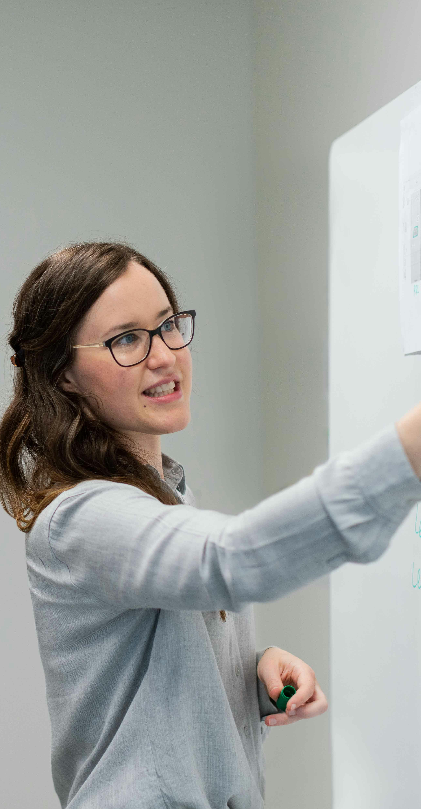
EESF Project Moves from Research to Action
We’re excited to share key updates from the Engineering Education for a Sustainable Future (EESF) project, as we move from foundational research to hands-on teaching and learning innovation. With WP2 now finalised and published on the project website, the EESF consortium is already deep into the development of WP3 – a dynamic phase focused on equipping engineering educators with practical, ready-to-use sustainability-focused resources.
Education is the most powerful weapon which you can use to change the world.
Nelson Mandela

Slide 3
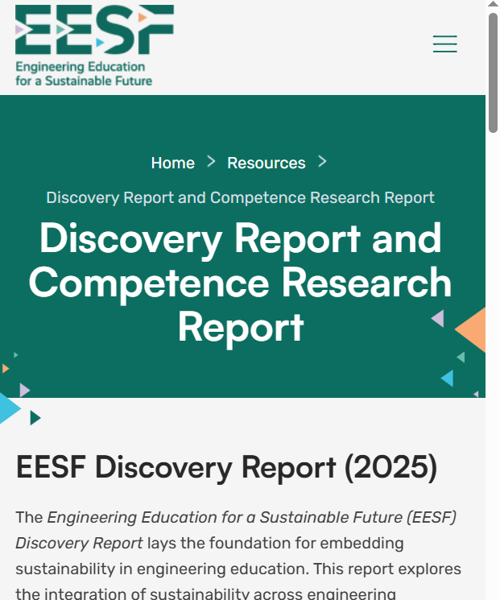
Spotlight
WP2 Complete: Discovery & Competence Reports Now Live
Earlier this year, the EESF consortium concluded Work Package 2: Discovery and Research, culminating in the release of two flagship reports;
1. Discovery Report
Explores how and why engineering education must align with the SDGs and highlights the current gaps in content and capacity across HEIs.
2. Embedding Sustainability Competences in Engineering Curricula
Synthesises input from 53 stakeholders across academia and industry, presenting real-world practices, tools, and pedagogic strategies for sustainability integration.
Both reports are now available for download at: eesfproject.eu/resources
These outputs provide the evidence base and pedagogic direction for the resources currently being developed under WP3.
Visit our EESF website

Slide 4
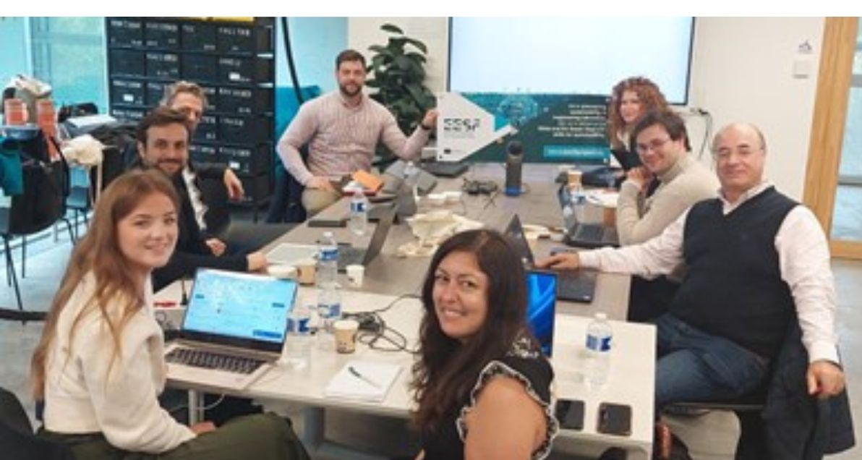
WP3 Teach and Learning Resources begins!
🚀 WP3 Launches with In-Person Exchange at IMTBS Campus, Paris
WP3 began with a face-to-face meeting hosted at the IMTBS campus in Paris in October 2024. Partners travelled from Ireland, Spain, Portugal, and Denmark to take part in this Teaching and Learning Exchange.
This session allowed the team to;
Discuss and agree the structure and goals of WP3
Share insights on target groups and teaching formats
Brainstorm module topics and resource needs
Review the competence and skills framework from WP2
Align on pedagogical approaches and development plans
The collaborative environment helped shape a clear and coherent vision for WP3 delivery.

Slide 5
Progress Update
What WP3 Teach and Learn aims to deliver
WP3 focuses on developing the Student Engineers for a Sustainable Future OER suite — a practical, flexible course aimed at embedding sustainability competences into engineering education.
Key Outputs
Four OER Modules (each led by a HEI partner) with real-world examples, activities, and media resources
Educator’s Guide for classroom, online, and hybrid delivery
Translations into project partner languages
Pilot testing at each partner HEI
Each module:
Addresses 3 selected sustainability competences
Offers 9 learning activities (3 per competence)
- Level 1: Basic (knowledge and theory, with quiz)
- Level 2: Advanced (application and analysis)
- Level 3: Integration (professional-level scenarios and discussion)
Will be design to take students through 315 to 540 minutes of learning content
All content is underpinned by a shared competence framework developed during WP2, which includes:
12 core sustainability competences
29 transversal and technical skills
18 core knowledge domains
The educational methodology is rooted in active, learner-centred pedagogy, supported by a catalogue of innovative teaching approaches compiled by EUEI (Denmark).
Partners are also encouraged to integrate multimedia elements using tools such as Fliki, RenderForest, and Canva.
5

Slide 6
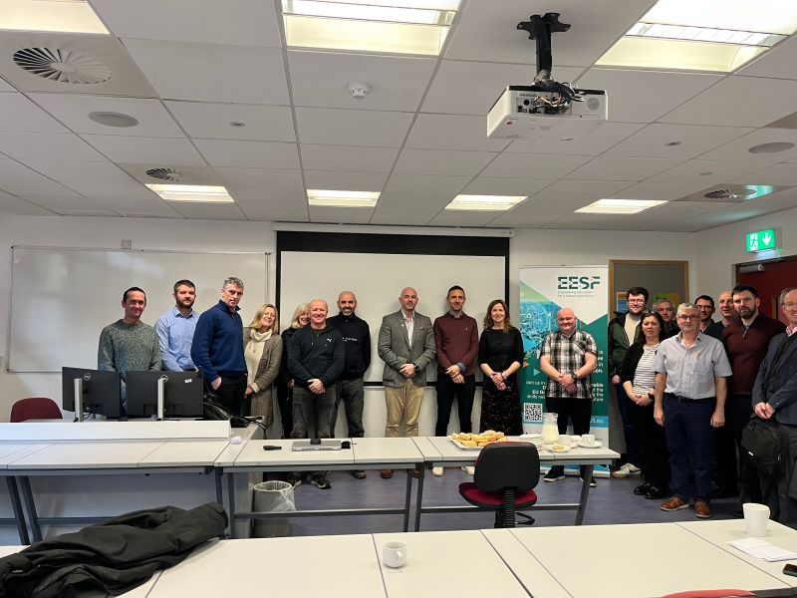
Dissemination Events
Atlantic Technological University, Ireland
Professor George Onofrei, from ATU, delivered a presentation to members of the Faculty of Engineering and Technology at ATU Donegal, focused on embedding sustainability in engineering education. This session explored how we, as educators, can better prepare our students to address global challenges through innovative teaching practices aligned with the Sustainable Development Goals (SDGs). Key highlights from the session included:
✅ The importance of sustainability competences: technical skills (e.g., renewable energy solutions, life cycle analysis), non-technical skills (e.g., teamwork, communication), and attitudes such as adaptability and systems thinking.
✅ Barriers to integration: Limited resources, curriculum constraints, and the need for more faculty training.
✅ Practical recommendations: Project-based learning, industry collaborations, and institutional frameworks like GreenComp to support sustainable teaching practices.
The session lead to discussions and debates, especially around:
• The role of interdisciplinary approaches in embedding sustainability across engineering disciplines.
• How to balance technical rigor with the broader societal and environmental impacts of engineering.
• The challenges of motivating both students and staff to embrace sustainability as a core value in education.
6

Slide 7
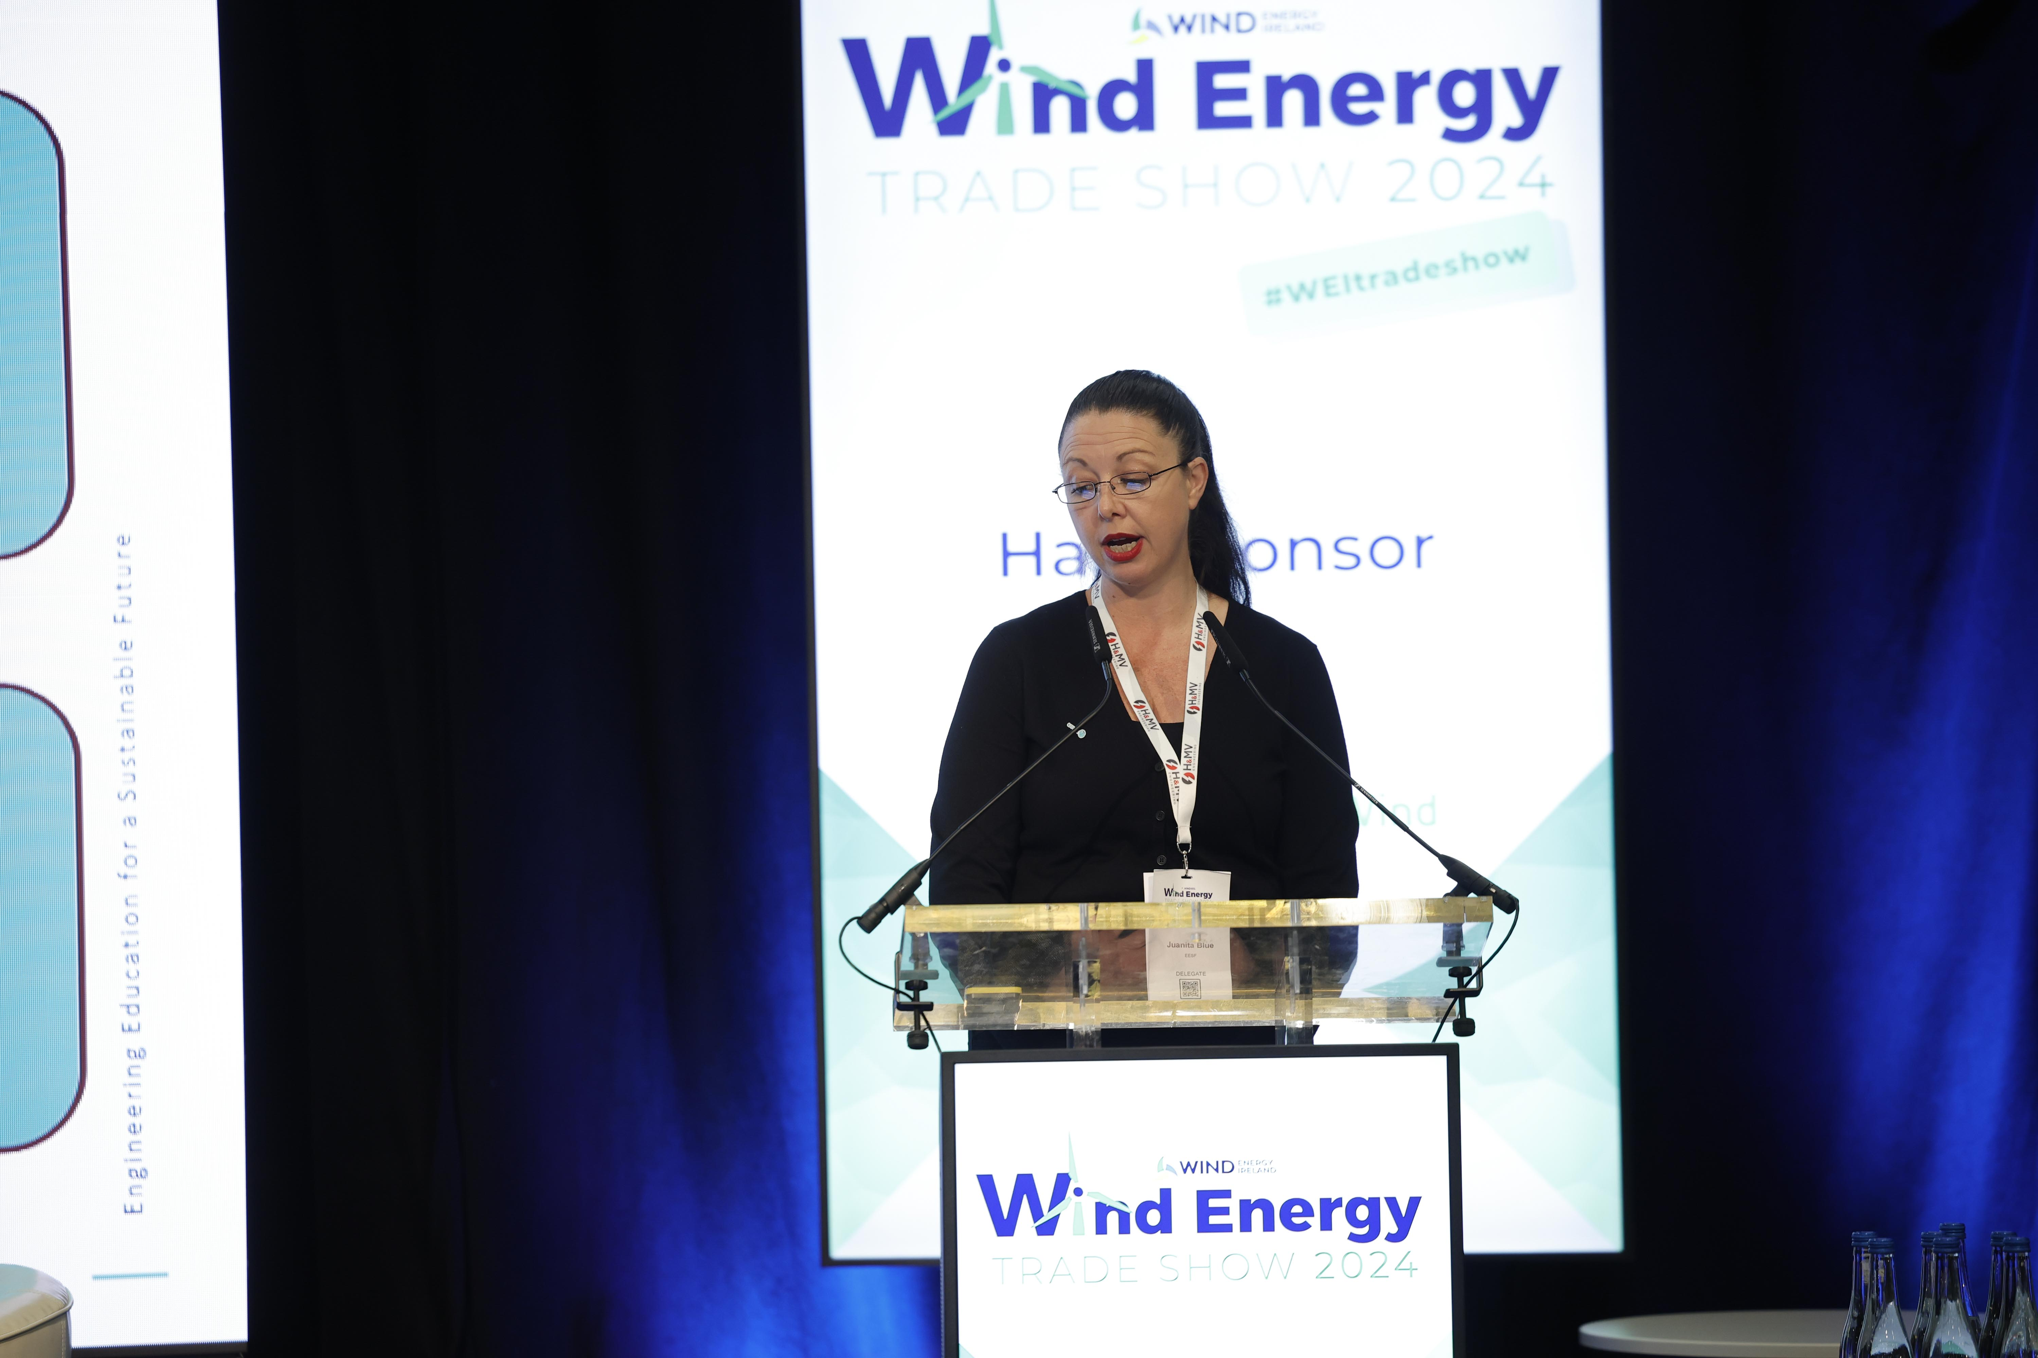
Dissemination Events
Wind Energy Ireland Trade Show 2024
The Wind Energy Ireland Trade Show offers a unique platform to explore the future of clean energy in Ireland and beyond. Ireland has already become a world leader in onshore wind and renewable energy integration and is harnessing vast offshore wind potential. As new projects enter the planning system and offshore wind auctions progress, Ireland’s future as a renewable energy hub continues to grow. This year’s show will dive into these exciting developments, highlighting the South Coast Designated Maritime Area Plan (DMAP), upcoming auctions, and Ireland's Future Framework vision for wind energy post-2030.
Juanita Blue from Atlantic Technological University (ATU), presented on the Research and Innovation Development of the project on Wednesday, 6th November, at 12 PM. Juanita’s presentation delved into the role of EESF in advancing sustainable engineering education and the crucial skills required to meet the demands of the rapidly evolving renewable energy sector.
7

Slide 8
Where we are at now
The consortium is currently…
Completing module drafts using a shared template
Designing interactive resources and activities
Preparing the Educator’s Guide, led by UPM and EUEI
Aligning all modules to ensure coherence in tone, format, and pedagogical approach
Planning for pre-publication, review, and translation (May–June 2025)
Why it matters
EESF directly addresses the growing need to prepare future engineers to meet the challenges of the 2030 Agenda. Through the creation of accessible, modular, and high-quality sustainability education resources, we are supporting engineering educators across Europe to embed sustainability meaningfully into their teaching — without requiring major curriculum overhauls.
Whether you're looking to supplement an existing course or deliver a focused SDG learning path, the EESF OERs will provide ready-made tools and guidance tailored for Higher Education settings.

Slide 9
Stay Connected
linkedin.com/company/engineering-for-a-sustainable-future/
www.eesfproject.eu

