Slide 1



Newsletter Issue #4
Scaling Impact through EU wide connection
www.idol.eu

Slide 2
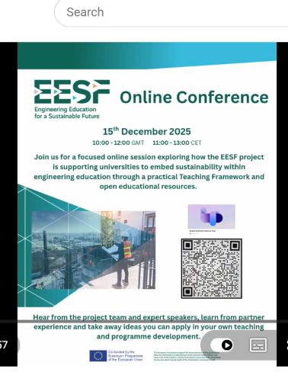
A Landmark Event: The EESF Online Conference
On 15 December 2025, the EESF consortium reached a defining milestone with its flagship European Online Conference.
Attended by 247 participants from across the continent, the event moved beyond project updates to spark a vital dialogue on the future of engineering education.
The session served as the formal stage to showcase our scientifically validated OER suite, now fully accessible to the global academic community.
Visit our EESF website

Slide 3
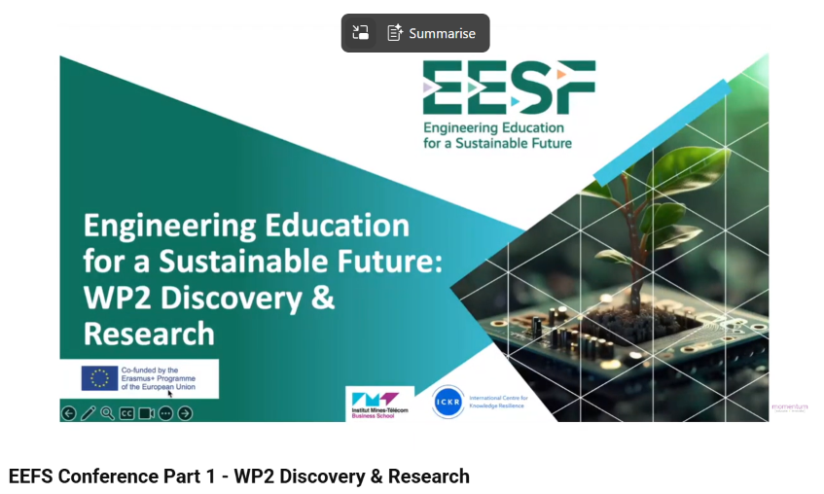
Insights from the EESF online conference
The conference featured a high-calibre line-up of speakers who provided a 360-degree view of why the EESF "solution" is critical for today’s challenges.
The Industrial Mandate: Michael Fitzgerald
Michael Fitzgerald, a veteran engineer in the electrical utility sector, delivered a powerful session on Technical Training for the Sustainability Transition.
The "Storm Éowyn" Case Study: Michael highlighted that during the massive January 2025 power outages in Ireland, repair crews had to be mobilised from Austria, Finland, the Netherlands, and France.
The Core Argument: He argued that sustainability is no longer a "separate chapter" but a core requirement for engineering analysis. Standardised European training—like the EESF framework—is essential to ensure a common operational skillset, allowing for more efficient emergency responses and cross-border skills mobility.

Slide 4
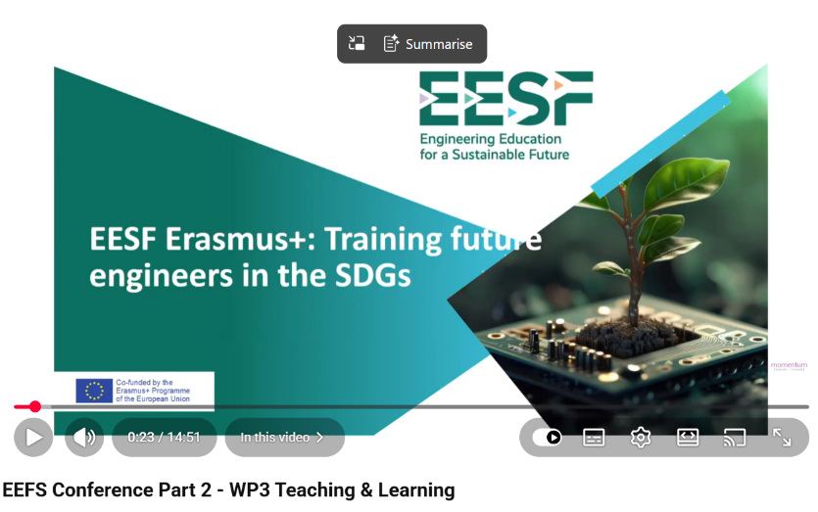
Insights from the EESF online conference
Academic Innovation: Professor Ângelo Algieri
Professor Algieri (University of Calabria) shifted the focus to the classroom, urging a move "from spectators to actors.“
Tackling Data Centres: Using the high energy consumption of global data centres (1.5% of global electricity) as a Problem-Based Learning (PBL) challenge, he demonstrated how students can be trained to design Circular Economy solutions, such as reusing server waste heat for urban systems.
The Goal: Transforming students into "Change Agents" capable of leading the transition toward cleaner, more sustainable infrastructures.

Slide 5
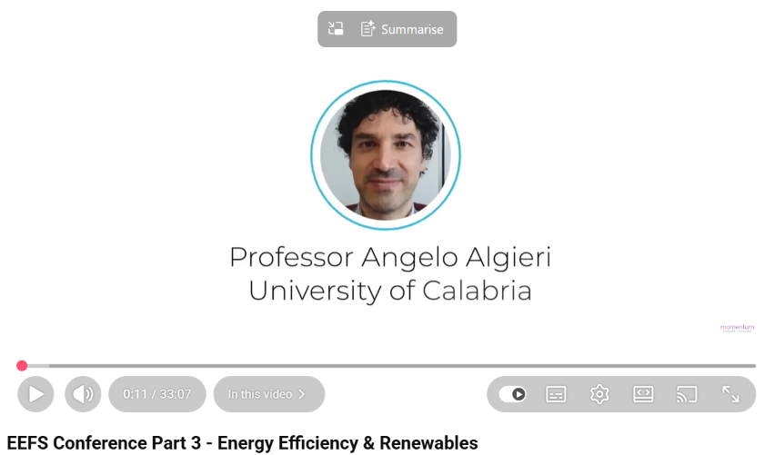
Insights from the EESF online conference
Scientific Excellence & Peer Review
The project’s credibility was further cemented by our recent presence at the TEEM 2025 Conference in Salamanca, Spain.
Academic Legacy: Our paper, "Outlining a case study for embedding sustainability competences," underwent rigorous peer review and is set for publication in the Springer Book Series "Lecture Notes in Educational Technology" (indexed in SCOPUS).
Validation: This ensures that the 22 teaching pedagogies we have developed are not just practical, but meet the highest international academic standards.

Slide 6
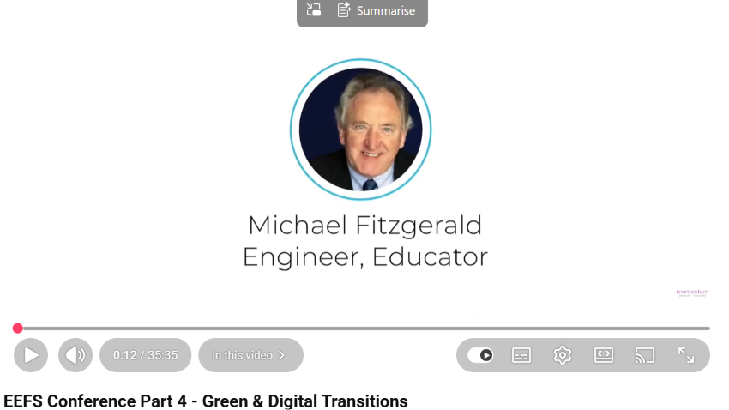
Insights from the EESF online conference
The "George" Effect: Impact by the Numbers
The conference addressed the "George" in every department, the educator who knows the SDGs are vital but lacks the curriculum space to teach them.
The Solution: Our OERs are built for scalability. Educators can choose a Level 1 "Basic" intervention (e.g., a 50-minute module on systems thinking) to fit their existing syllabus.
Current Reach:
247 Conference Participants.
200+ Students reached via pilot tests.
40 Educators actively implementing the framework across 4 European universities.
4 Languages: Full suites in English, Spanish, French, and Portuguese.

Slide 7
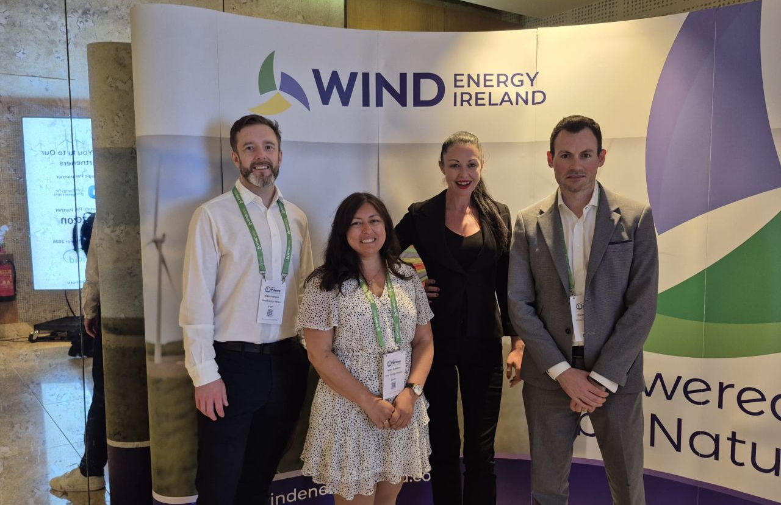
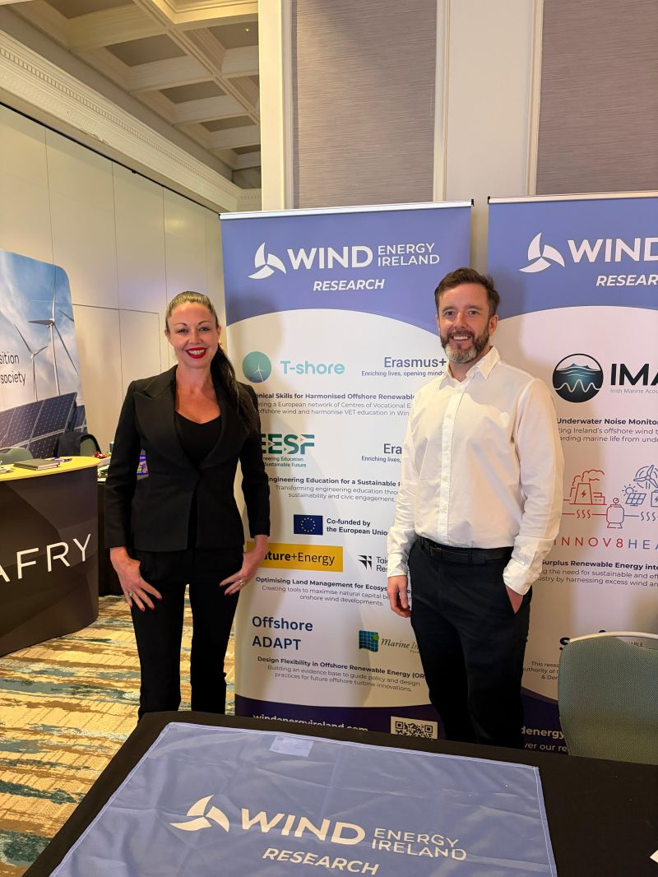
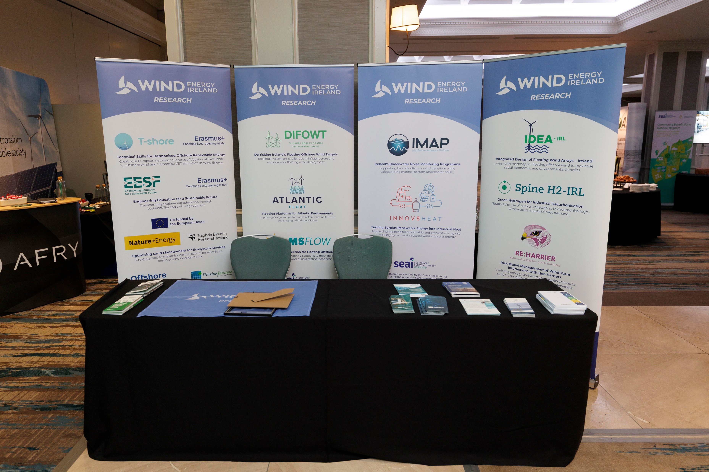
EESF Featured at Wind Energy Ireland Offshore Conference
The Engineering Education for a Sustainable Future (EESF) project was recently showcased at the Wind Energy Ireland Offshore Conference, held in Dublin, Ireland on 26–27 May 2026. The project featured at the WEI Research Stand, which highlighted a range of ongoing collaborative research and innovation initiatives supporting the offshore renewable energy sector.
Project partners Wind Energy Ireland and Atlantic Technological University were represented at the event, with Dr. Sarah Kandrot, Eva McCarthy and Patrick Cantwell (WEI), alongside Juanita Blue (ATU), engaging with conference delegates about the EESF project and new Training Hub.
The Offshore Conference brought together industry leaders, researchers, policymakers, and stakeholders from across the offshore wind sector, providing an excellent opportunity to raise awareness of the EESF project and discuss the importance of embedding sustainability competences within engineering education and workforce development.

Slide 8
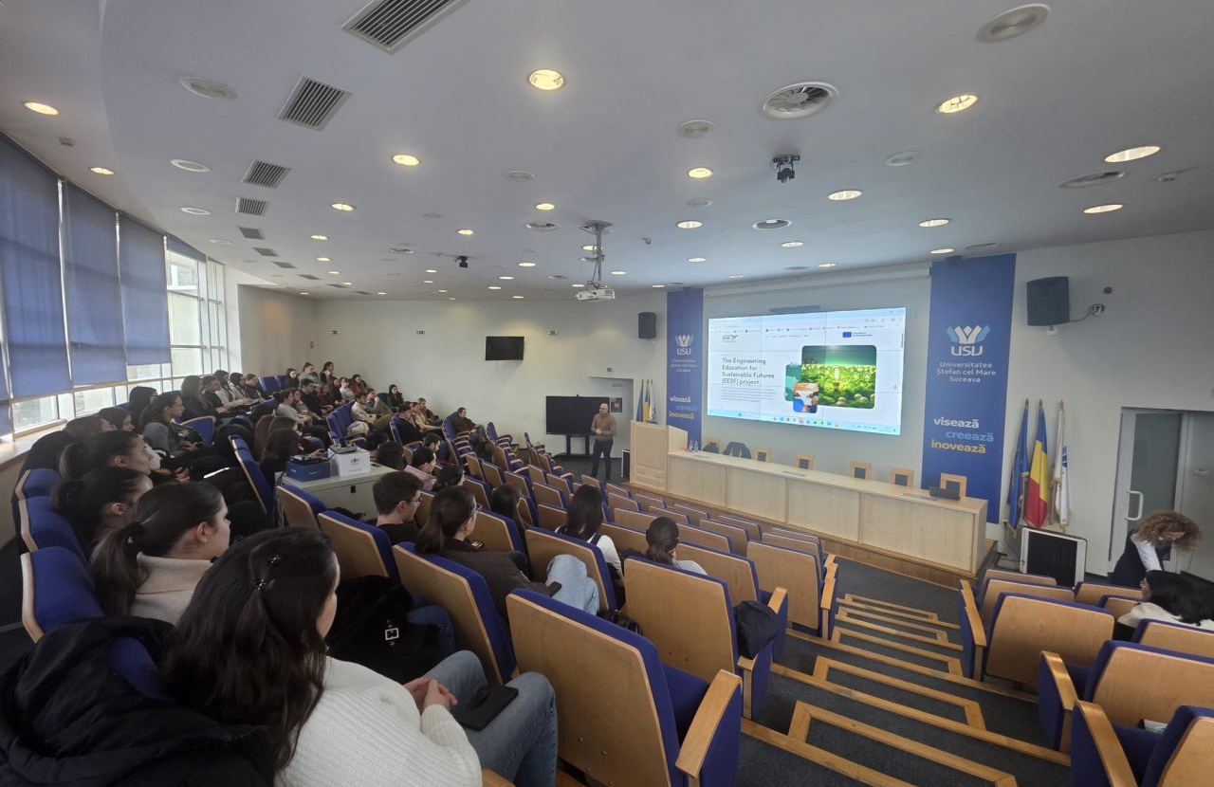
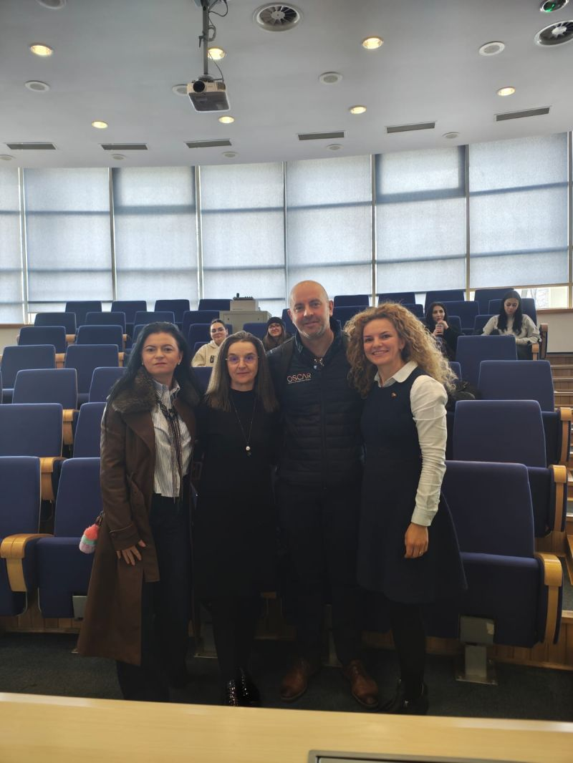
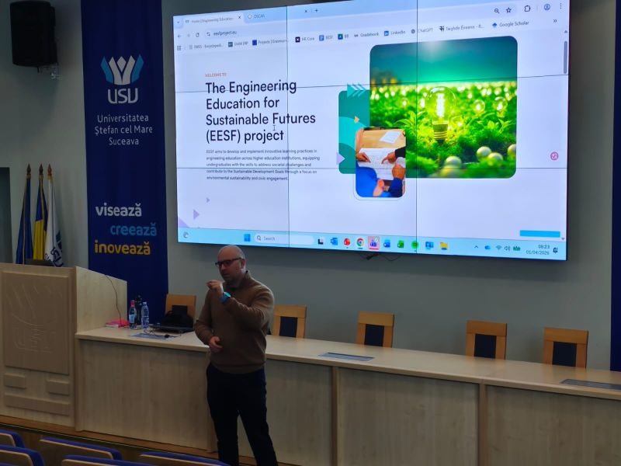
ATU showcasing the EESF project to staff and students at Stefan cel Mare University
Professor George Onofrie had the opportunity to present at Stefan cel Mare University of Suceava, România about the EESF (Engineering Education for Sustainable Futures) project to students and staff.
It was a really engaging session discussing how we can better embed sustainability competences into engineering and business education, and how initiatives like EESF can support both educators and learners in navigating the transition toward more sustainable futures.
A sincere thank you to Prof. @Ana Maria Bores for the kind invitation and warm welcome.
Encouraging to see such strong interest and openness to integrating sustainability into teaching and learning.
.

Slide 9
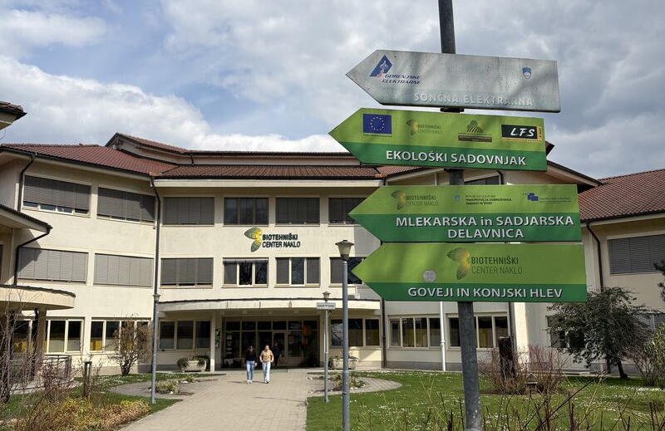
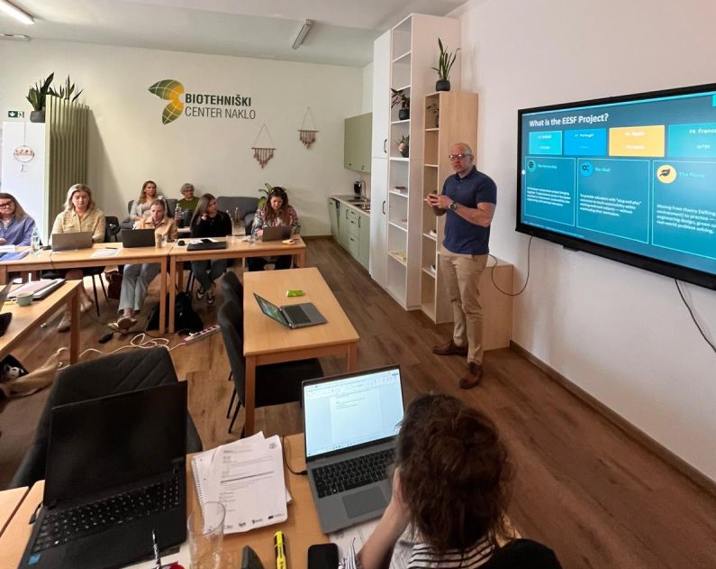
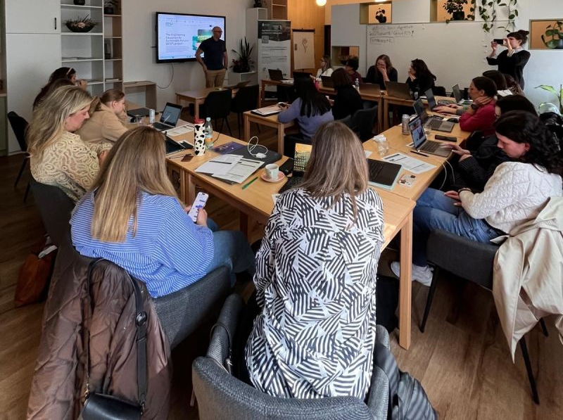
ATU showcasing the EESF project to teachers at Biotehniski Center Naklo
Professor George Onofrie was visiting Kranj, Slovenia in March and presented the EESF project and sharing our work on embedding sustainability into education with teachers at Biotehniški Center Naklo.
It was a really engaging session with VET teachers, exploring how practical, project-based approaches and open educational resources can support the integration of sustainability competences into teaching. The discussions were very engaging , especially around what works in real classrooms and where support is still needed.
A big thank you to Dr Lisa Ryan (RNutr) and Aisling Moran for the invitation and for bringing us together with the ReImagine Food project partners. These kinds of collaborations are exactly what we need to move from ideas to implementation..

Slide 10
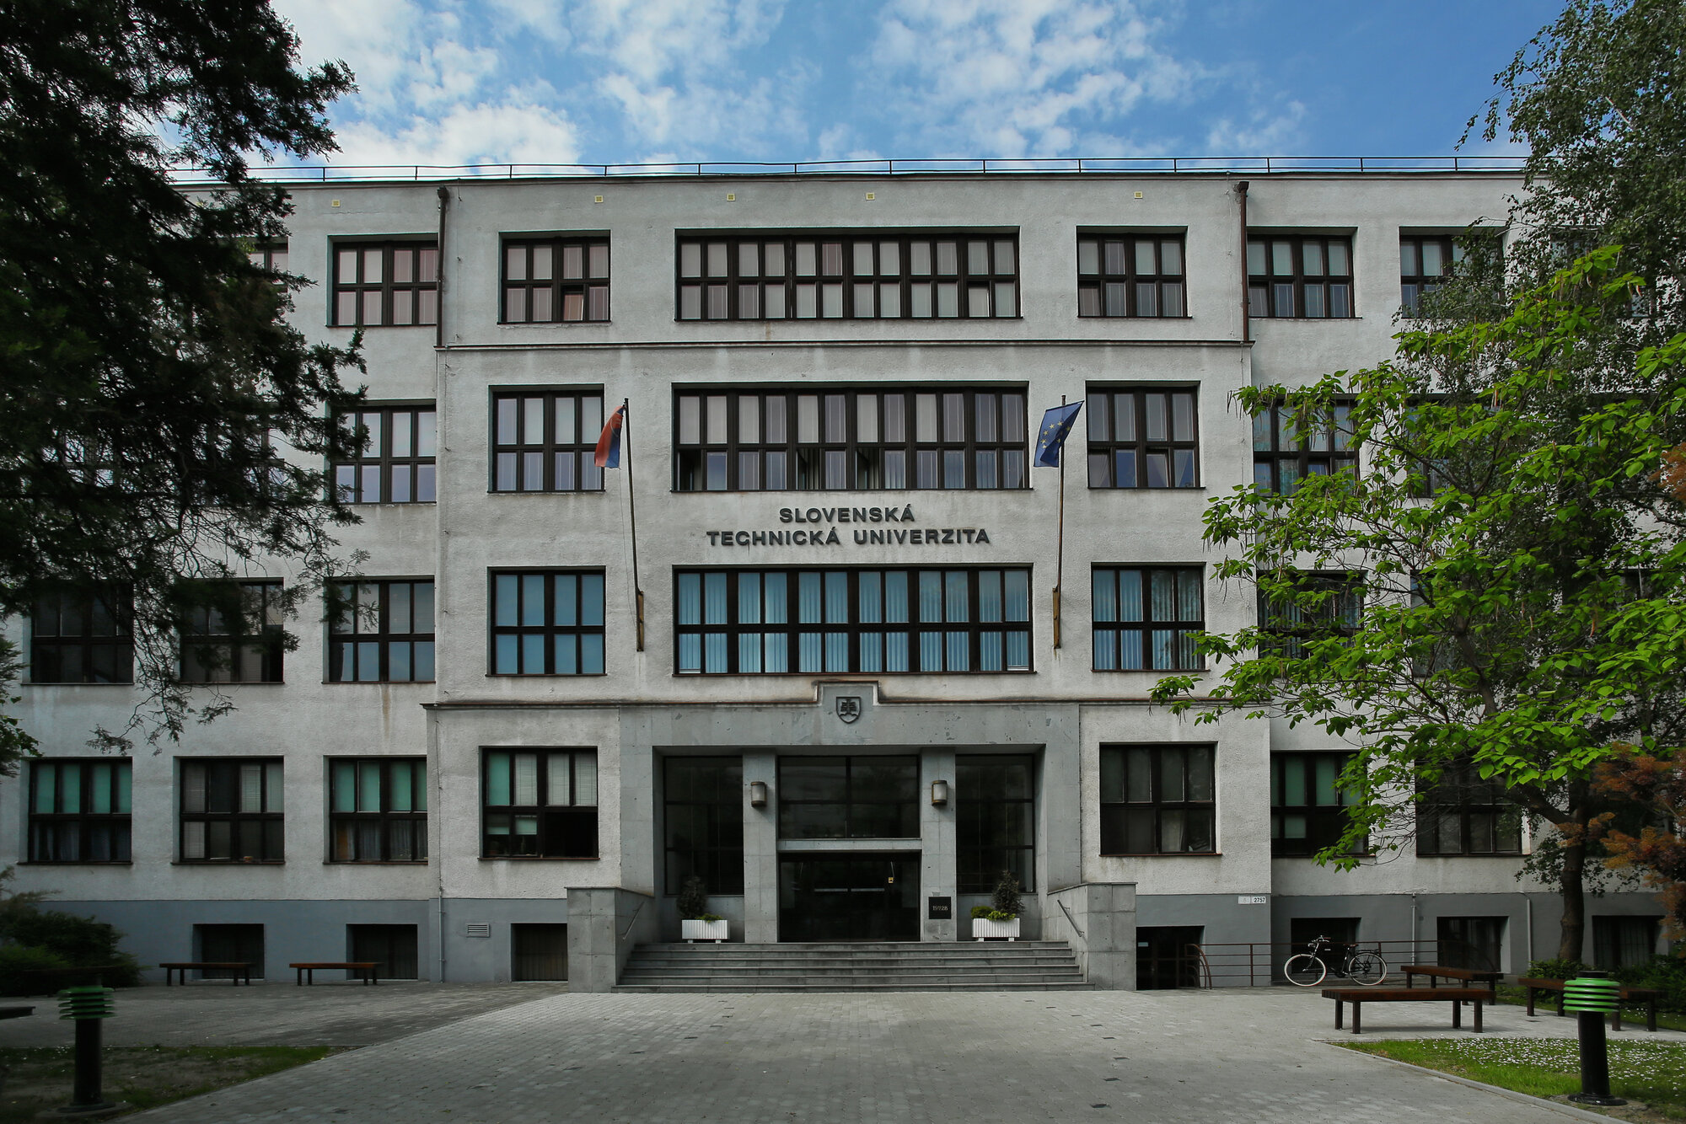
P.Porto showcasing the EESF project at the Slovak University of Technology
The EESF Project presentation was delivered by P. Porto, Engineer Carlos Felgueiras, and Engineer Paulo Silva at the Slovak University of Technology in Bratislava on April 30, 2026. The session highlighted key aspects of the project, focusing on its technical developments and contributions to sustainable energy solutions. It took place in an academic setting under the guidance of Miroslava Smitkova, a lecturer specializing in renewable energy sources, ecology, and hydrogen technologies. Her expertise provided valuable context and support for the discussion of innovative approaches within the energy sector.

Slide 11
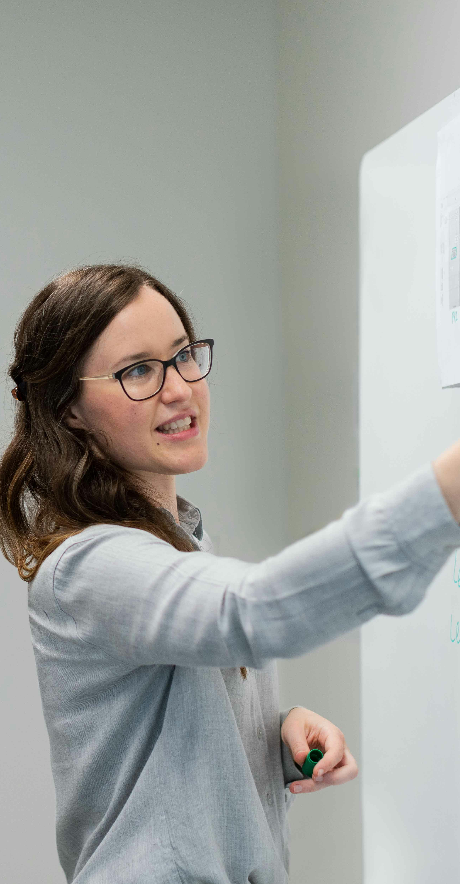

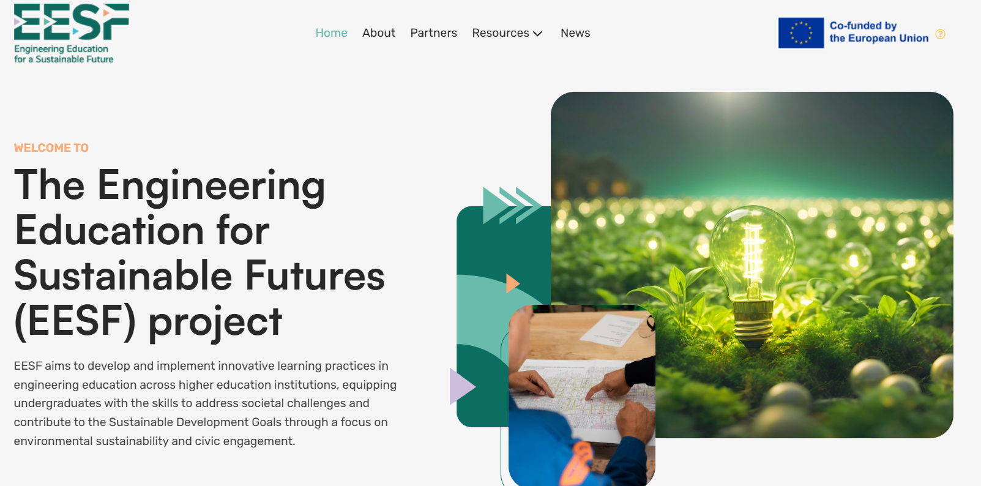
Looking ahead
As we enter our final phase, EUEI is ensuring the Digital Platform remains a long-term "Solution Hub.“ EUEI’s team will ensure the EESF resources remain visible and accessibility long after the project ends
Our Creative Commons-licensed resources are a legacy for the entire engineering community.
Join the movement.
Access the OERs, the Educator's Guide, and our academic findings at:
www.eesfproject.eu

Slide 12
Stay Connected
linkedin.com/company/engineering-for-a-sustainable-future/
www.eesfproject.eu

